Slide 1
Check-ins, August

Slide 2
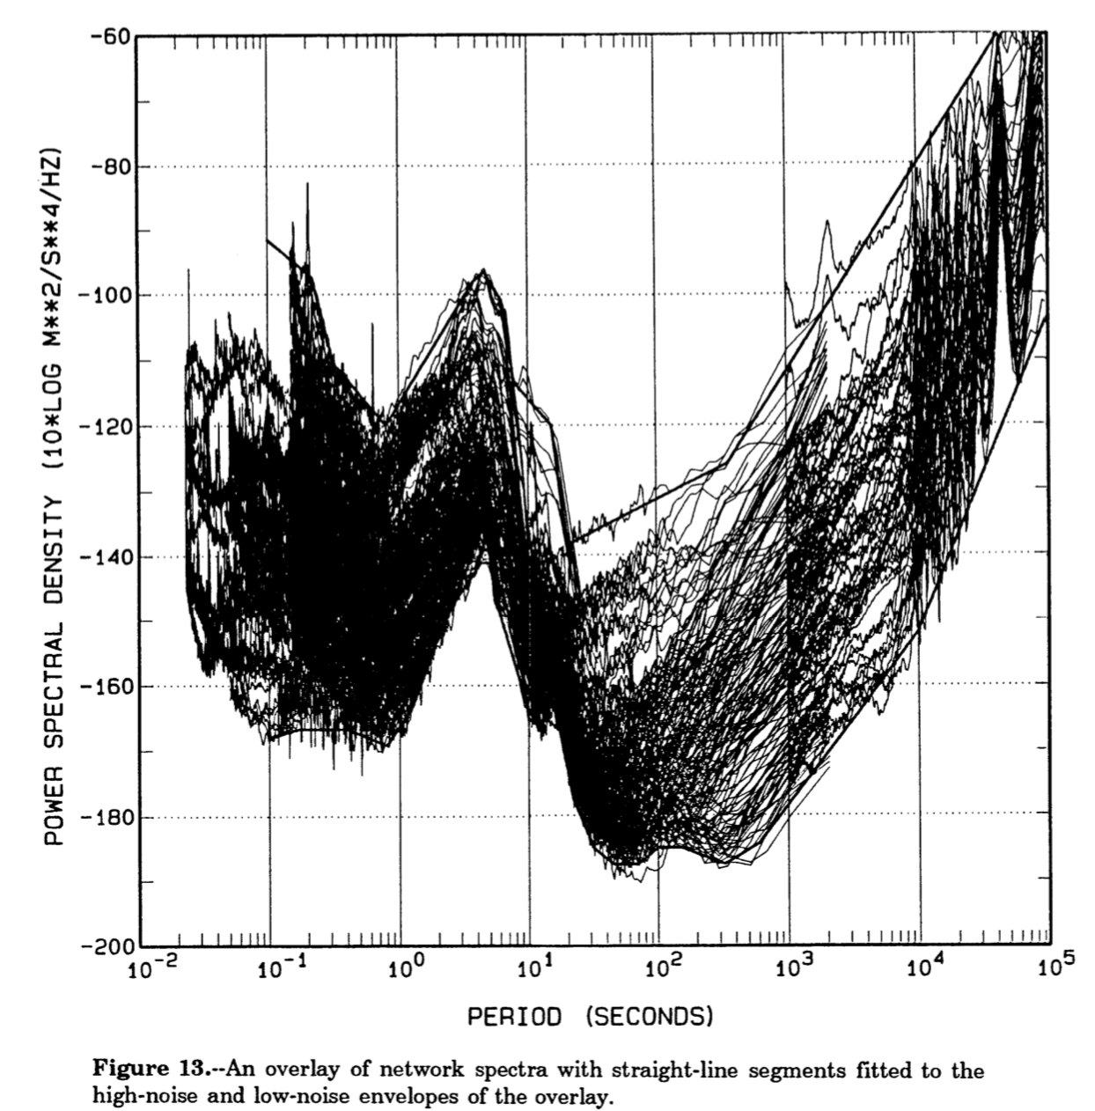
Peterson (1993)
Upper and lower boundary “high” and “low” noise models
Not continuous, discrete points with linear interpolation
This is power spectral density
Units: (m^2/s^4)/Hz

Slide 3
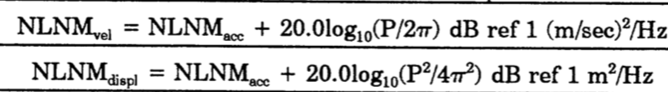
Peterson (1993)
Provides formulae for linear interpolants
2 models (high/low) and 3 “flavors”
Acceleration (Power spectral density)
Units: (m^2/s^4)/Hz
Velocity (Not power anymore I don’t think? Another type of spectral density?)
Units: (m/s^2)/Hz
Displacement (Another type of spectral density)
Units: (m^2)/Hz

Slide 4
Peterson (1993)
How to take PSD or the other integrated relationships and apply to a clean signal to create a noisy one?
It’s spectral density (energy / frequency), multiplying by frequency content of a signal then?
Multiplication in frequency domain → convolution in the time domain
Not totally sure

Slide 5
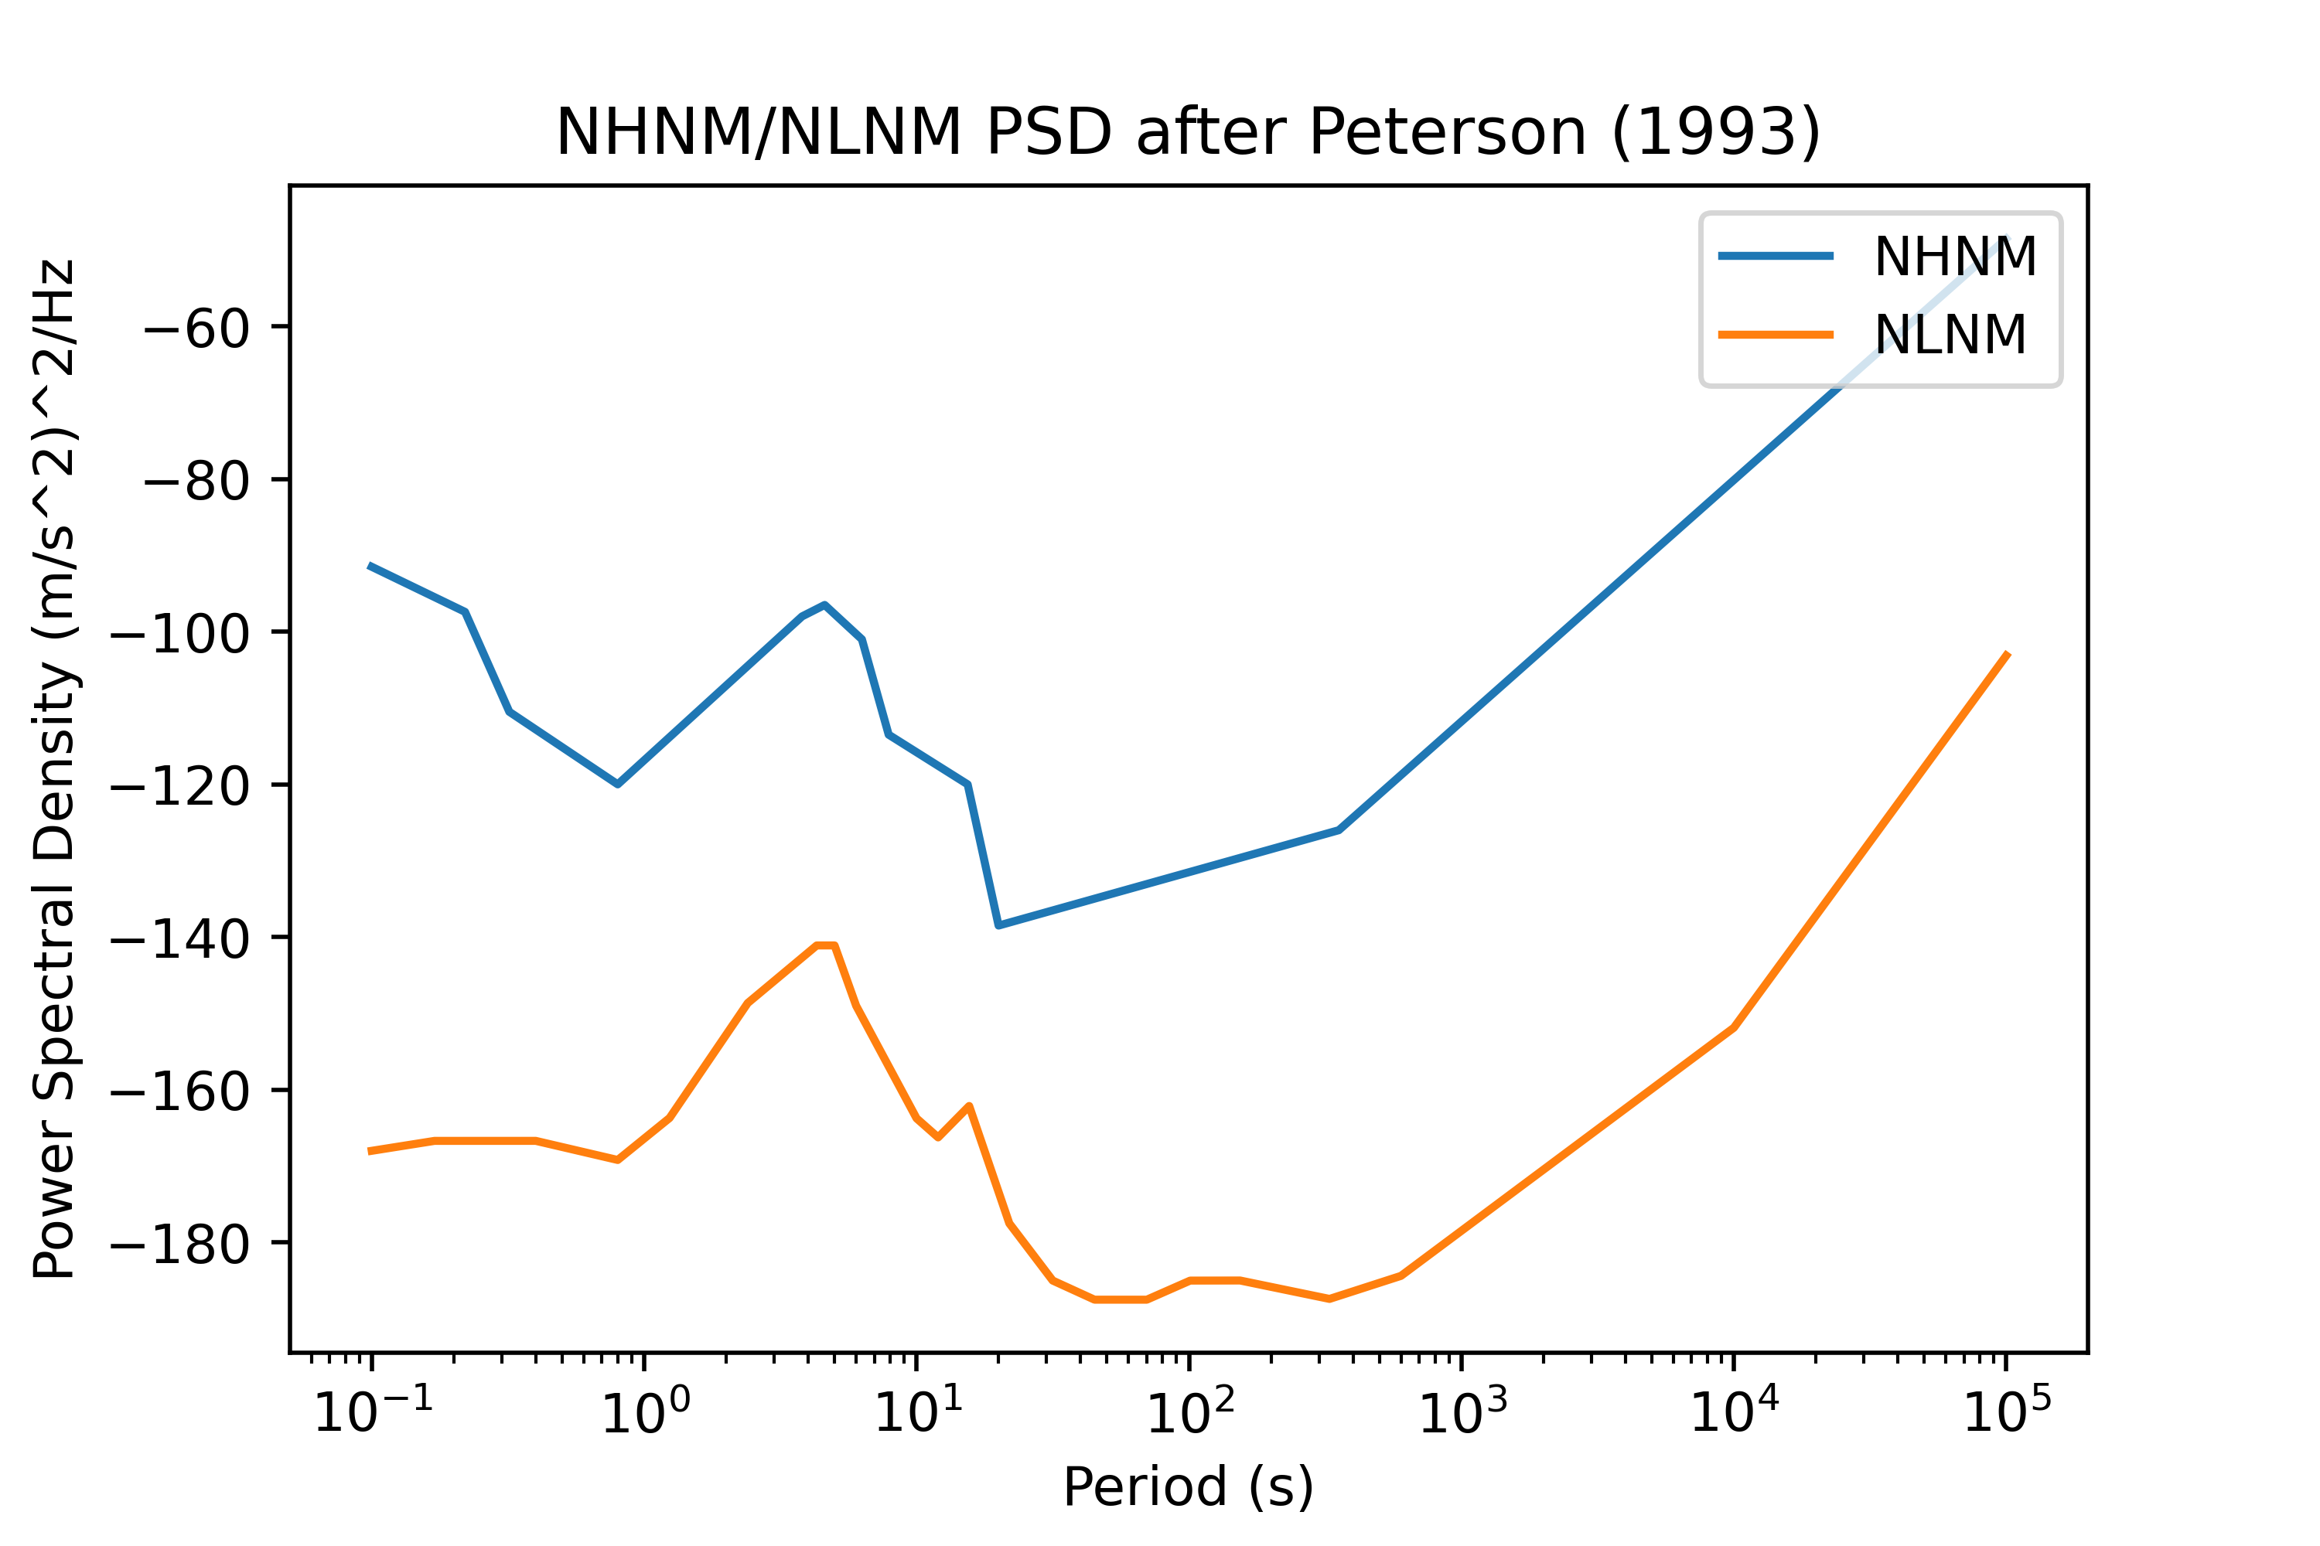
Have the models ready to use

Slide 6
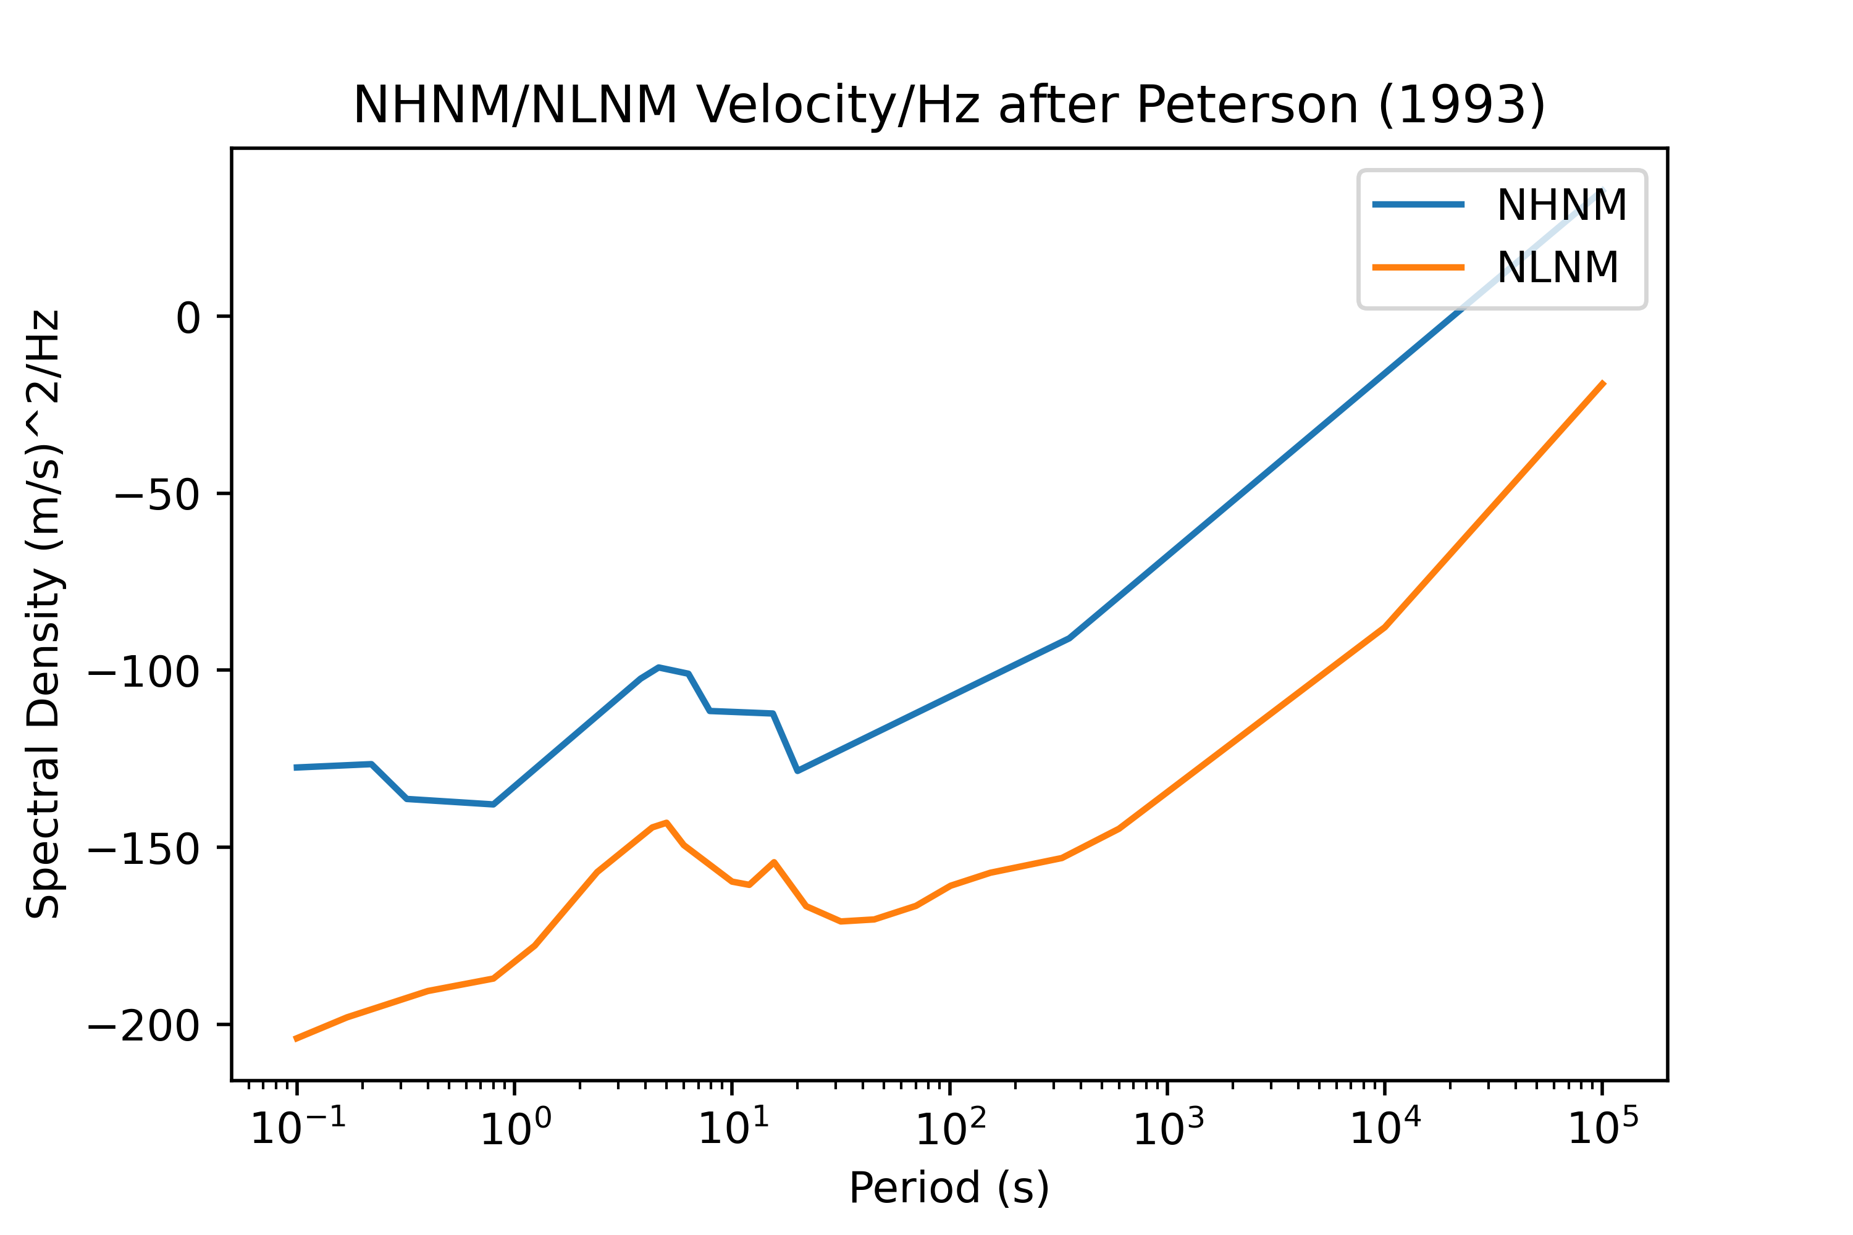
Have the models ready to use

Slide 7
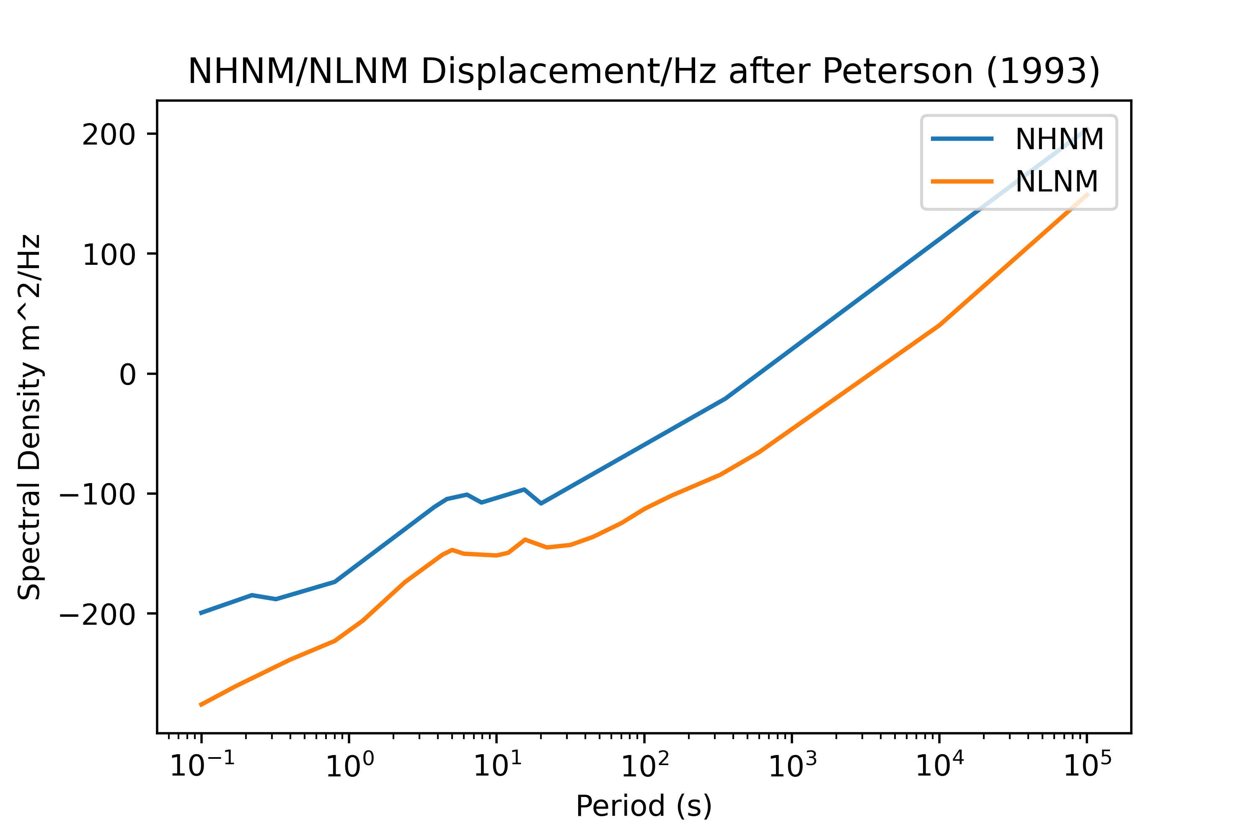
Have the models ready to use

Slide 8
Getting more continues noise models?
Interpolate with a more complex, mostly continuous function?
Just get values at adjacent points and linearly interpolate as needed?
Maybe the simpler the better …

Slide 9
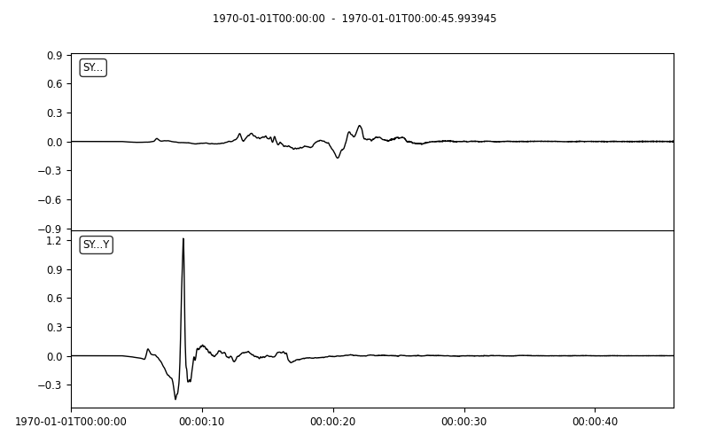
Kyle’s Synthetics

Slide 10
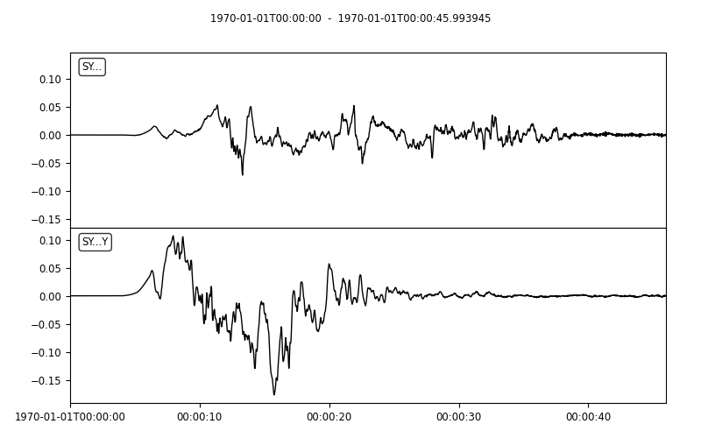
Kyle’s Synthetics

Slide 11
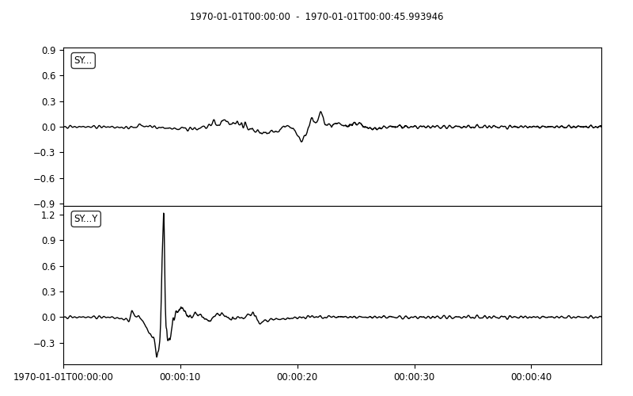
Kyle’s Synthetics + My other noise funcs
Randomized phases add in freq domain, limited to 1-3Hz content

Slide 12
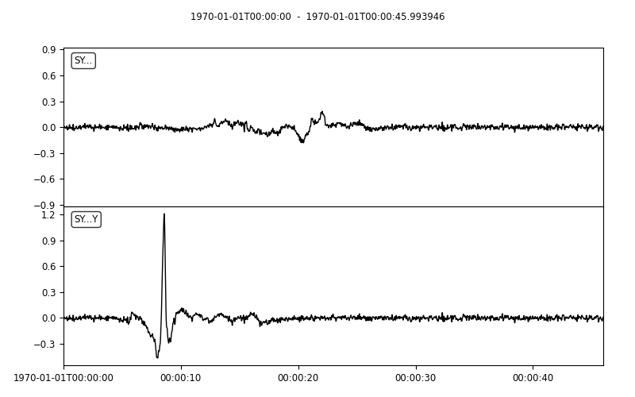
Kyle’s Synthetics + My other noise funcs
Randomized phases add in freq domain, limited to .1-10Hz content

Slide 13
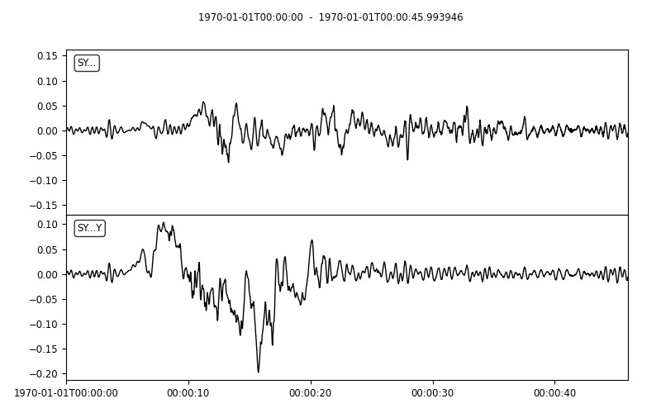
Kyle’s Synthetics + My other noise funcs
Randomized phases add in freq domain, limited to 1-3Hz content

Slide 14
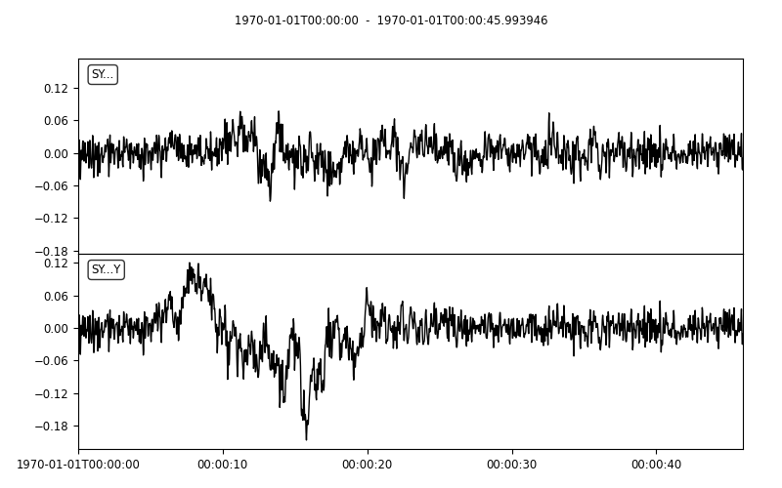
Kyle’s Synthetics + My other noise funcs
Randomized phases add in freq domain, limited to .1-10Hz content

Slide 15
Power spectral density vs. power spectra and units / operations in general

Slide 16
Units …
“This article is about specifying the units of the Discrete Fourier Transform of an image and the various ways that they can be expressed. This apparently simple task can be fiendishly unintuitive.”
https://www.strollswithmydog.com/units-of-discrete-fourier-transform/

Slide 17
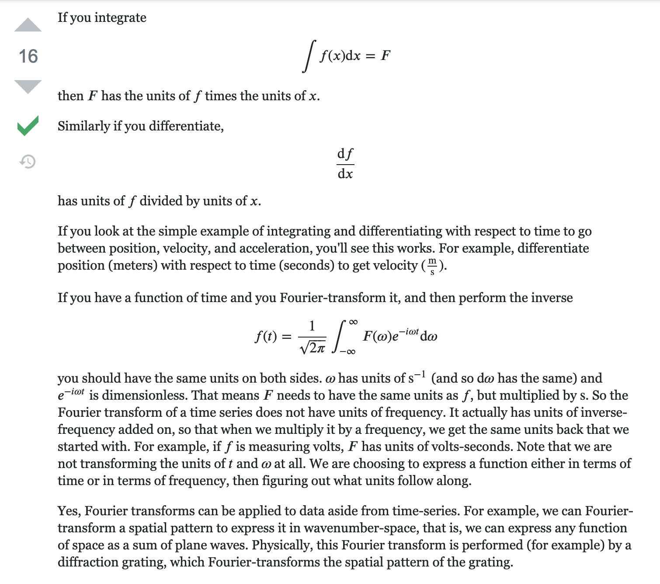
Units

Slide 18
Start out using existing methods
NumPy FFT and iFFT
SciPy Welchs() method
Constructs overlapping periodograms that are used to estimate power spectral density (PSD in units of (m/s)²/Hz) or linear spectrum of RMS velocity (m/s)

Slide 19
Info
Helpful links
https://www.researchgate.net/post/What_does_FFT_transform_affect_on_the_acceleration_unit_Is_it_m_s2_in_frequency_domain
https://femci.gsfc.nasa.gov/random/randomgrms.html

Slide 20
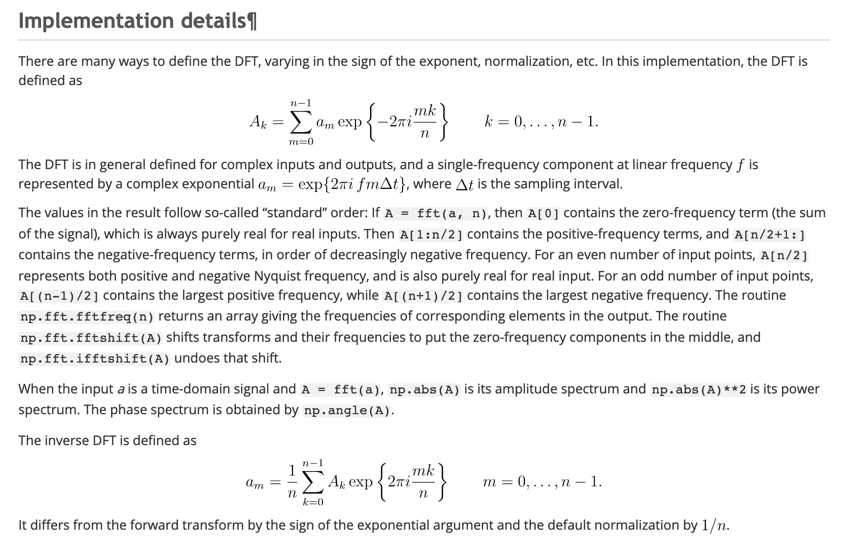
NumPy fft() and ifft() after Cooley and Tukey (1965)

Slide 21
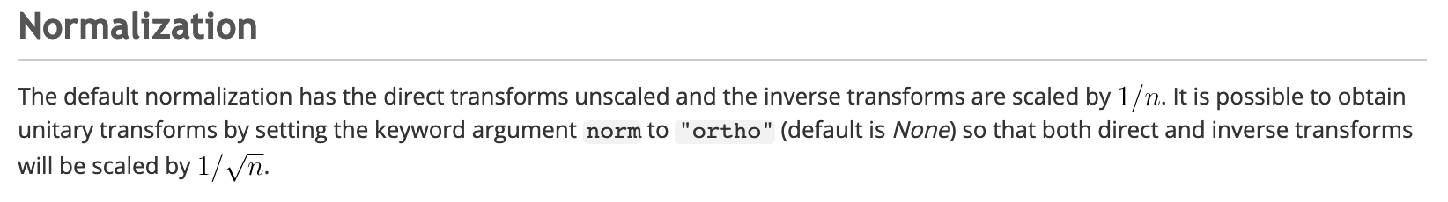
NumPy/SciPy fft() and ifft() after Cooley and Tukey (1965)

Slide 22
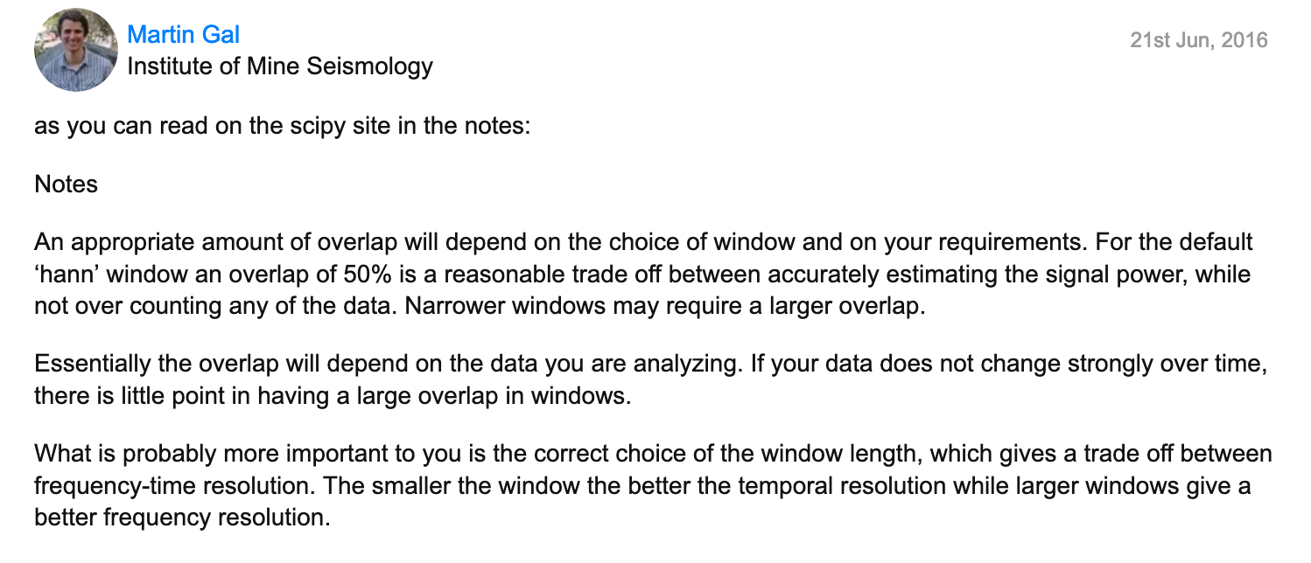
On windows and Welch’s method

Slide 23
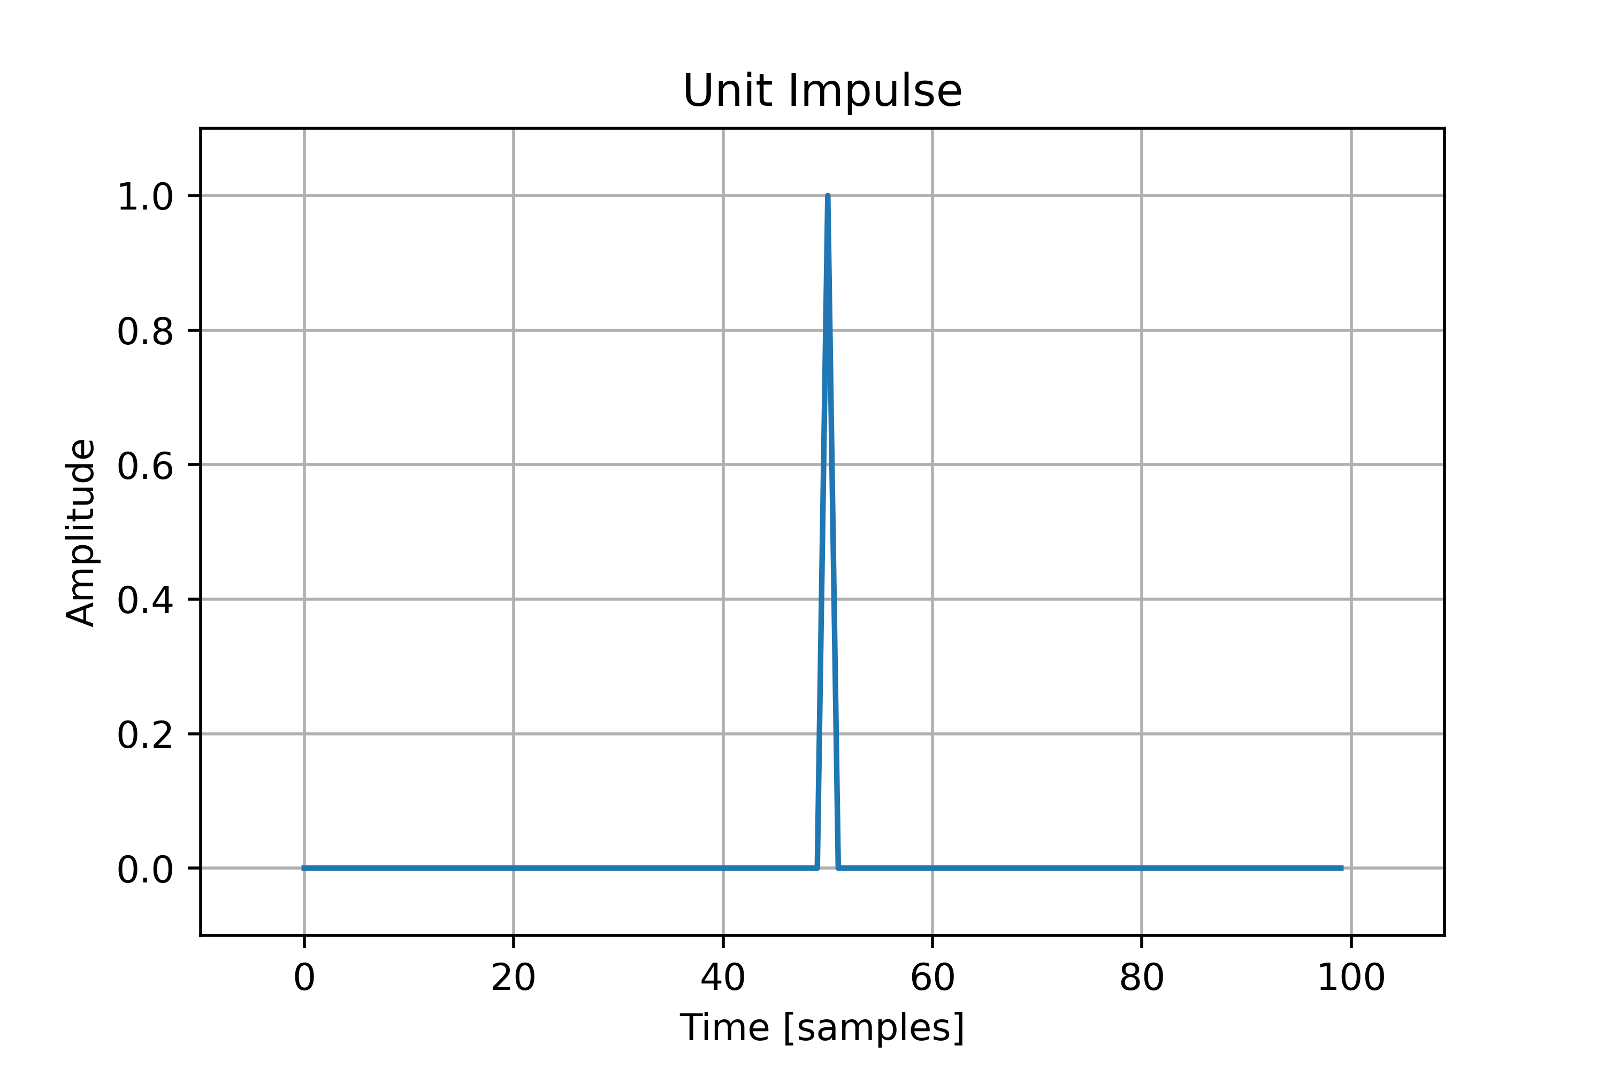
Unit impulse

Slide 24
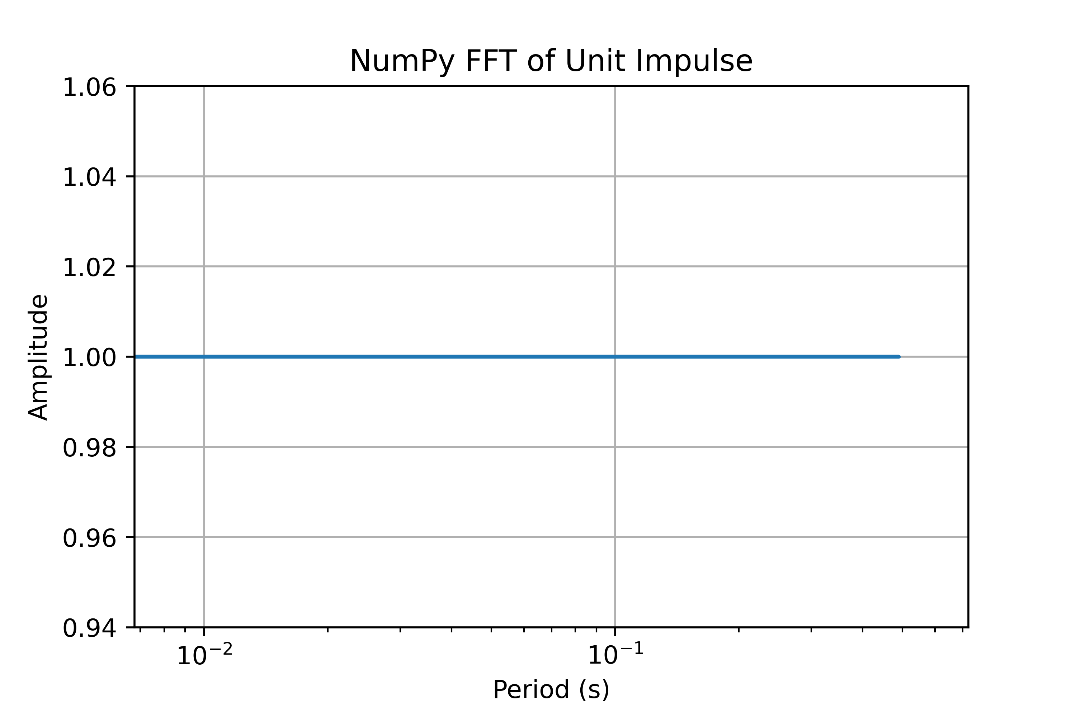
This is the absolute value of amplitude (absolute value)

Slide 25
PSD from Welch’s Method – Default values

Slide 26
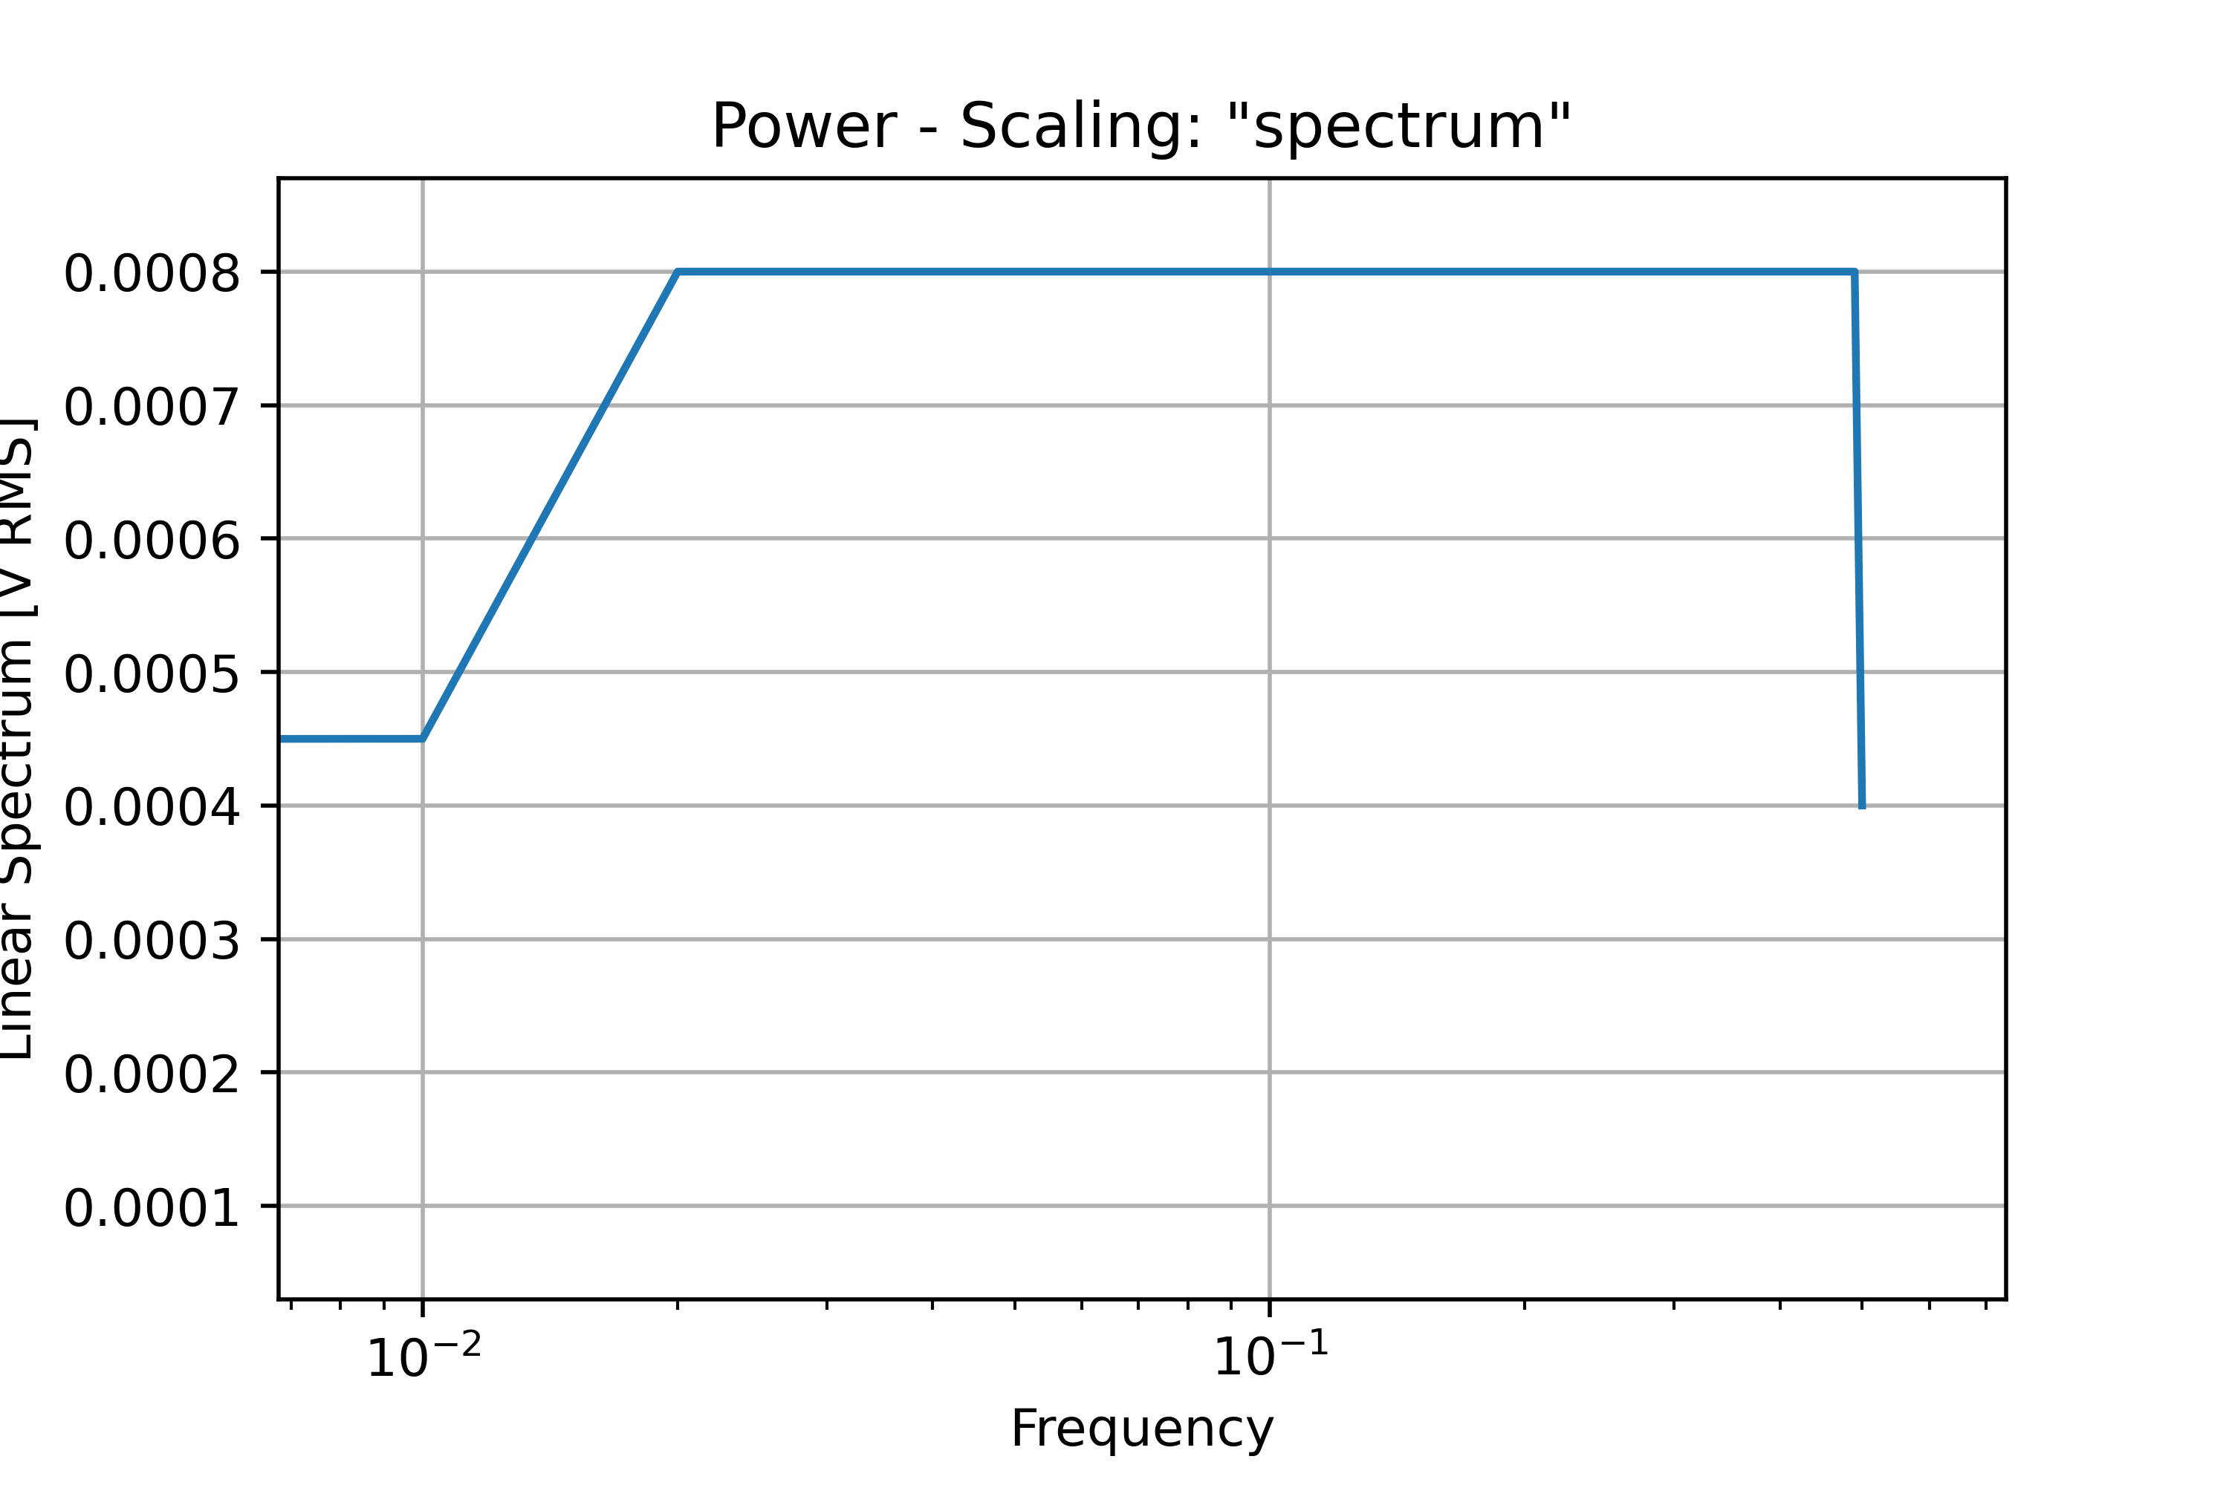
Units of (m/s) RMS reportd by SciPy Welch() method for computing power spectrum

Slide 27
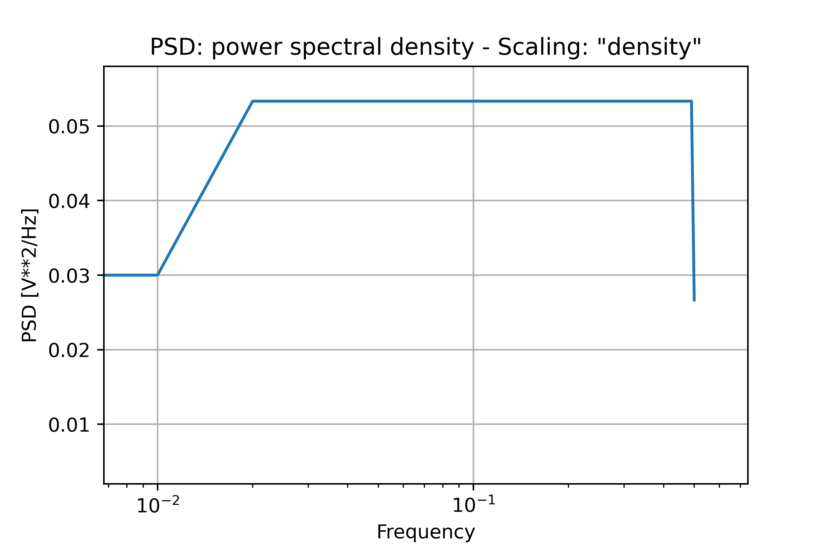
Units of (m/s)²/Hz report by SciPy Welch() method for computing PSD

Slide 28
Differing Scaling

Slide 29
Checking Periodic Signals

Slide 30
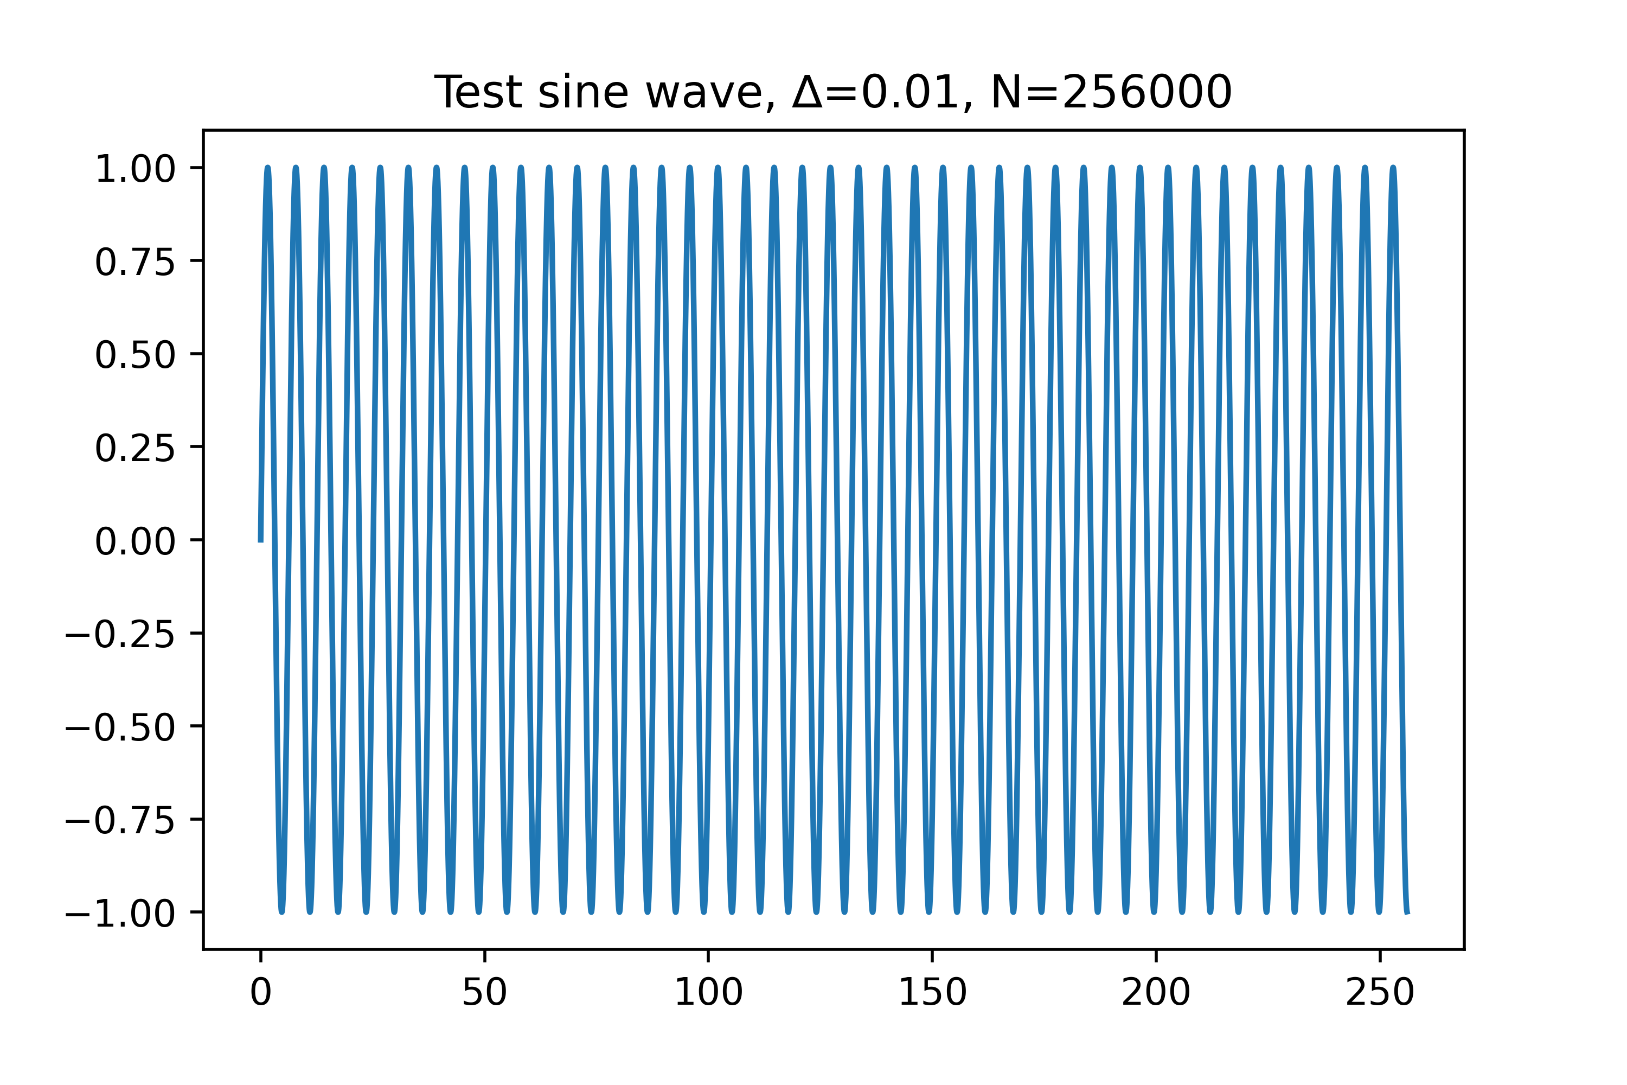
Understanding Scaling – Welch’s Method - Test sine() Signal

Slide 31
Welch’s Method – Parameter Tuning

Slide 32
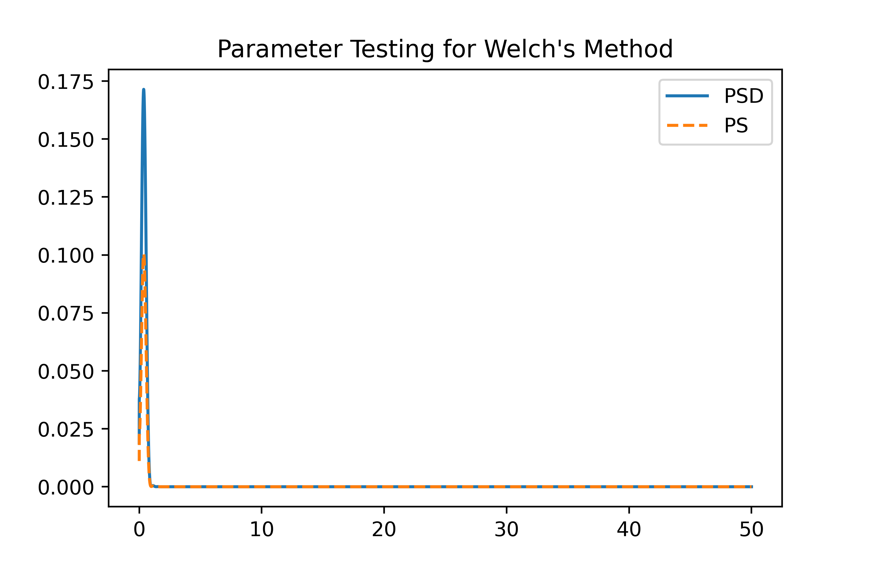
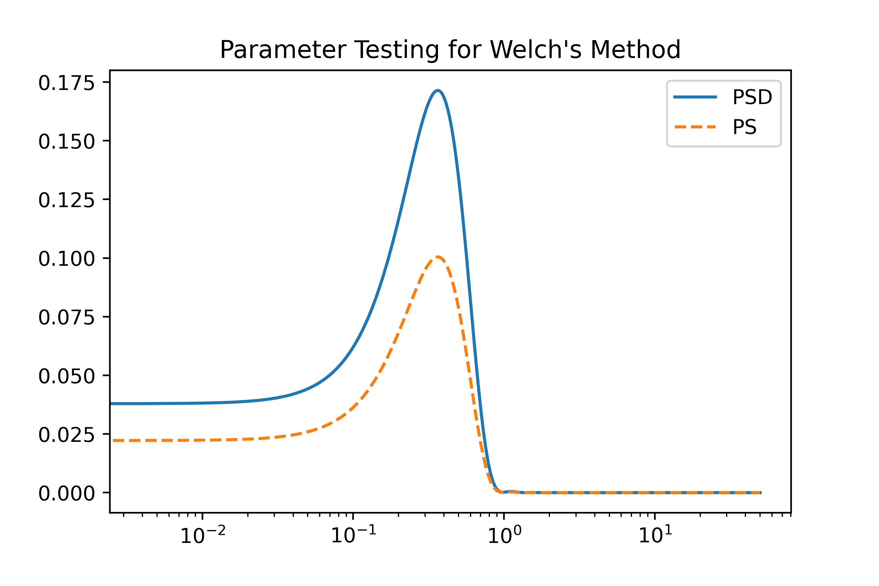
Setting fs (0.01) and nfft (as full length)

Slide 33
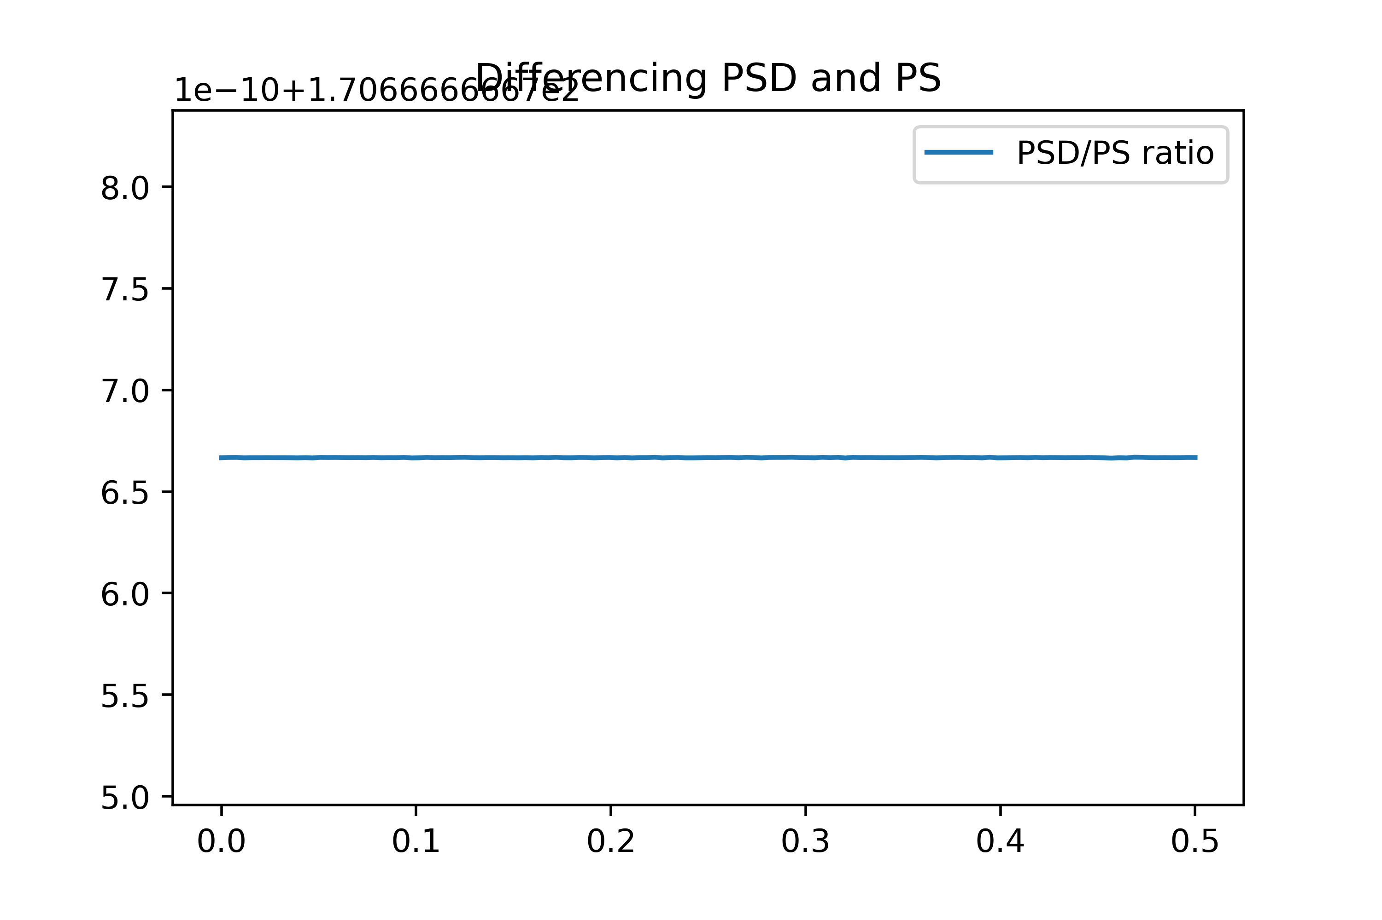
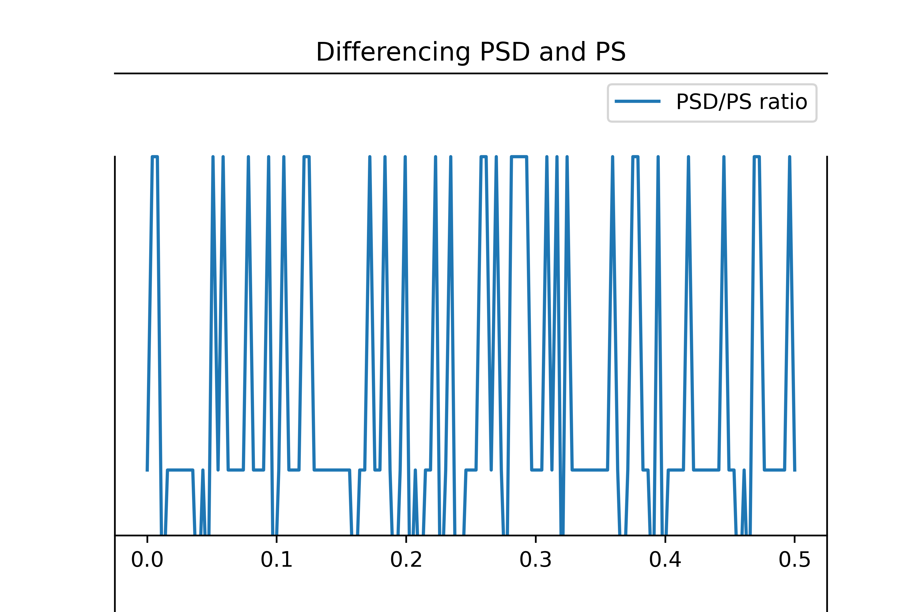
PSD / PS
Plotting PSD/PS ratios to see scaling differences
170.666 repeating. Variations are rounding differences
∆ = .01 ; nFFT = 256,000
nfft = len(t) , no nperseg arg set

Slide 34
PSD / PS
Why 170.667??

Slide 35
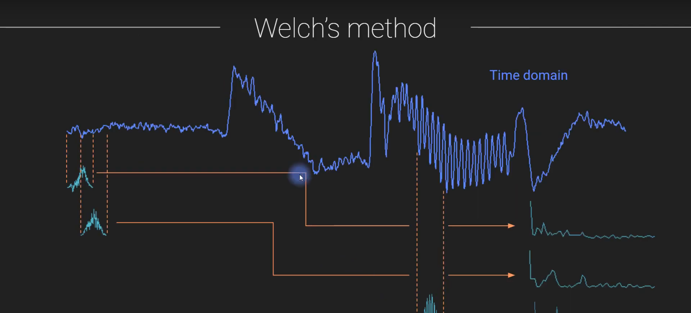
Parameter Tuning
Welch’s method greatly influenced by window size and overlap

Slide 36
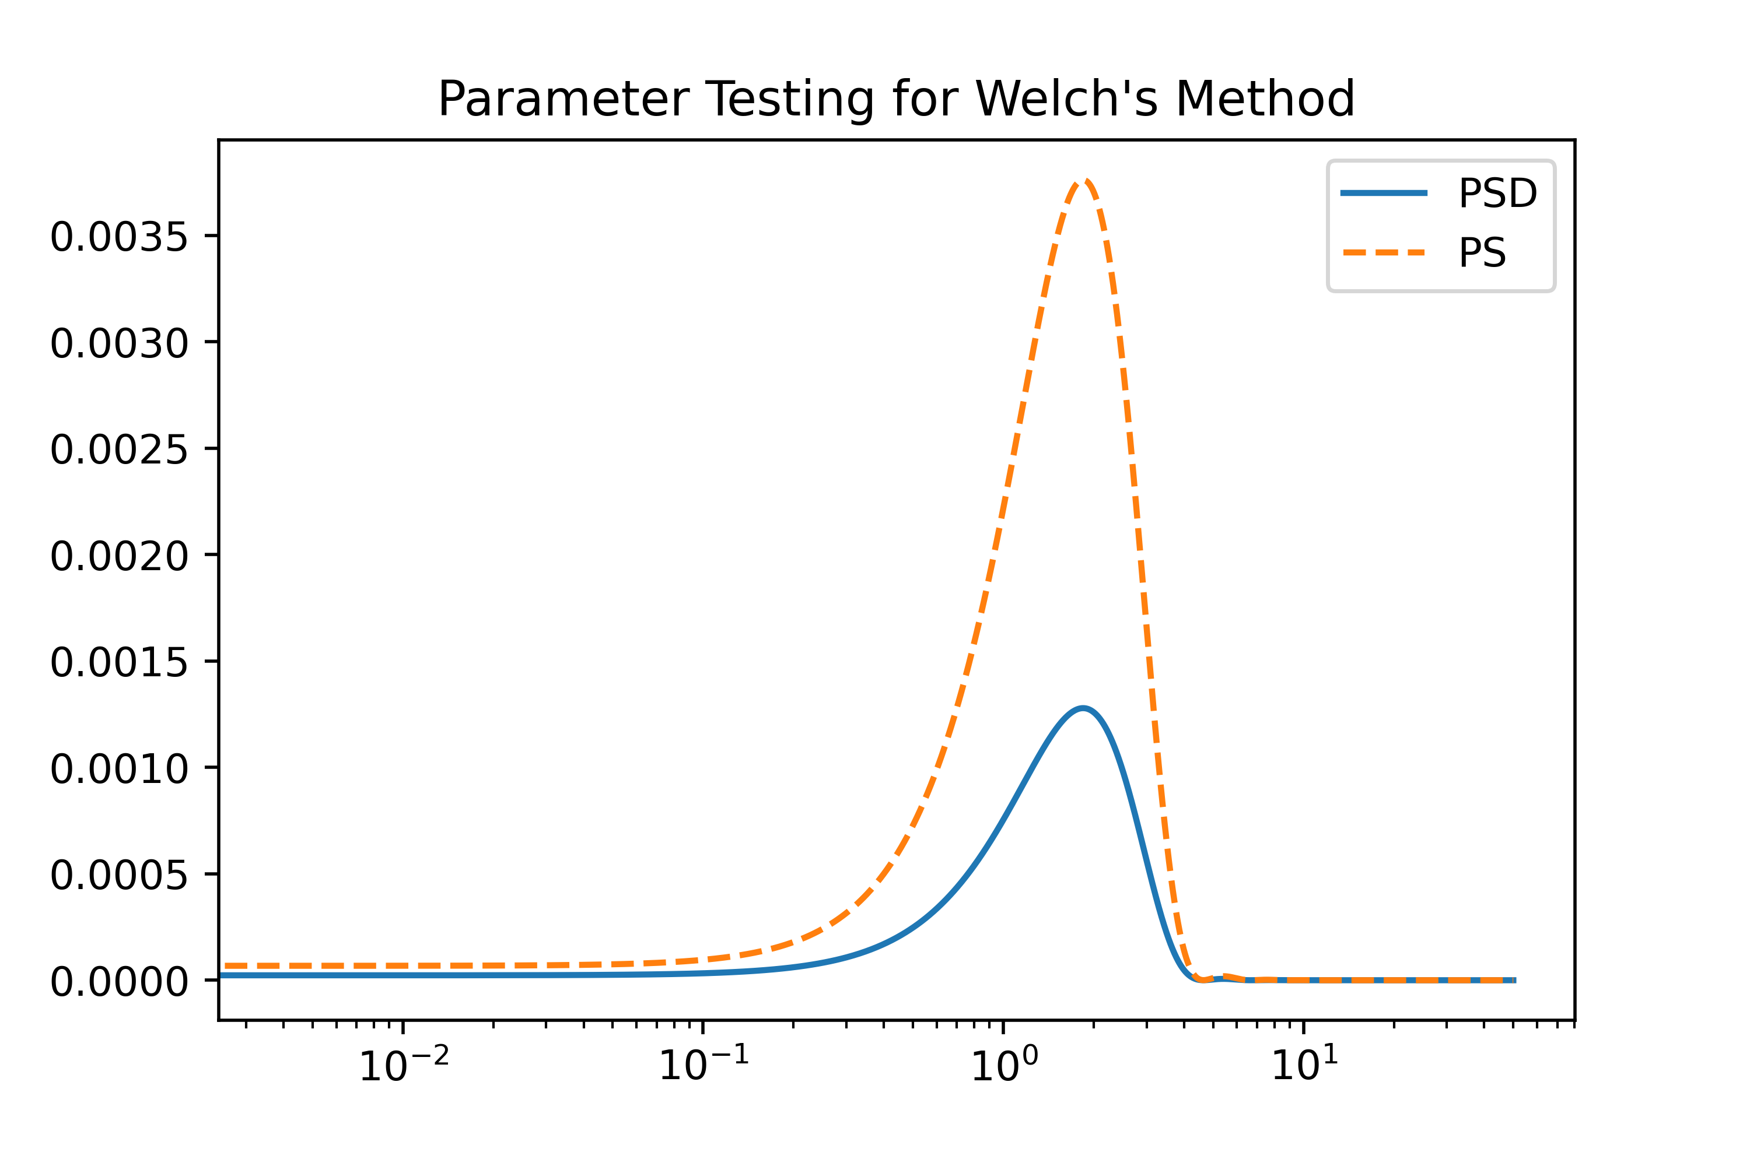
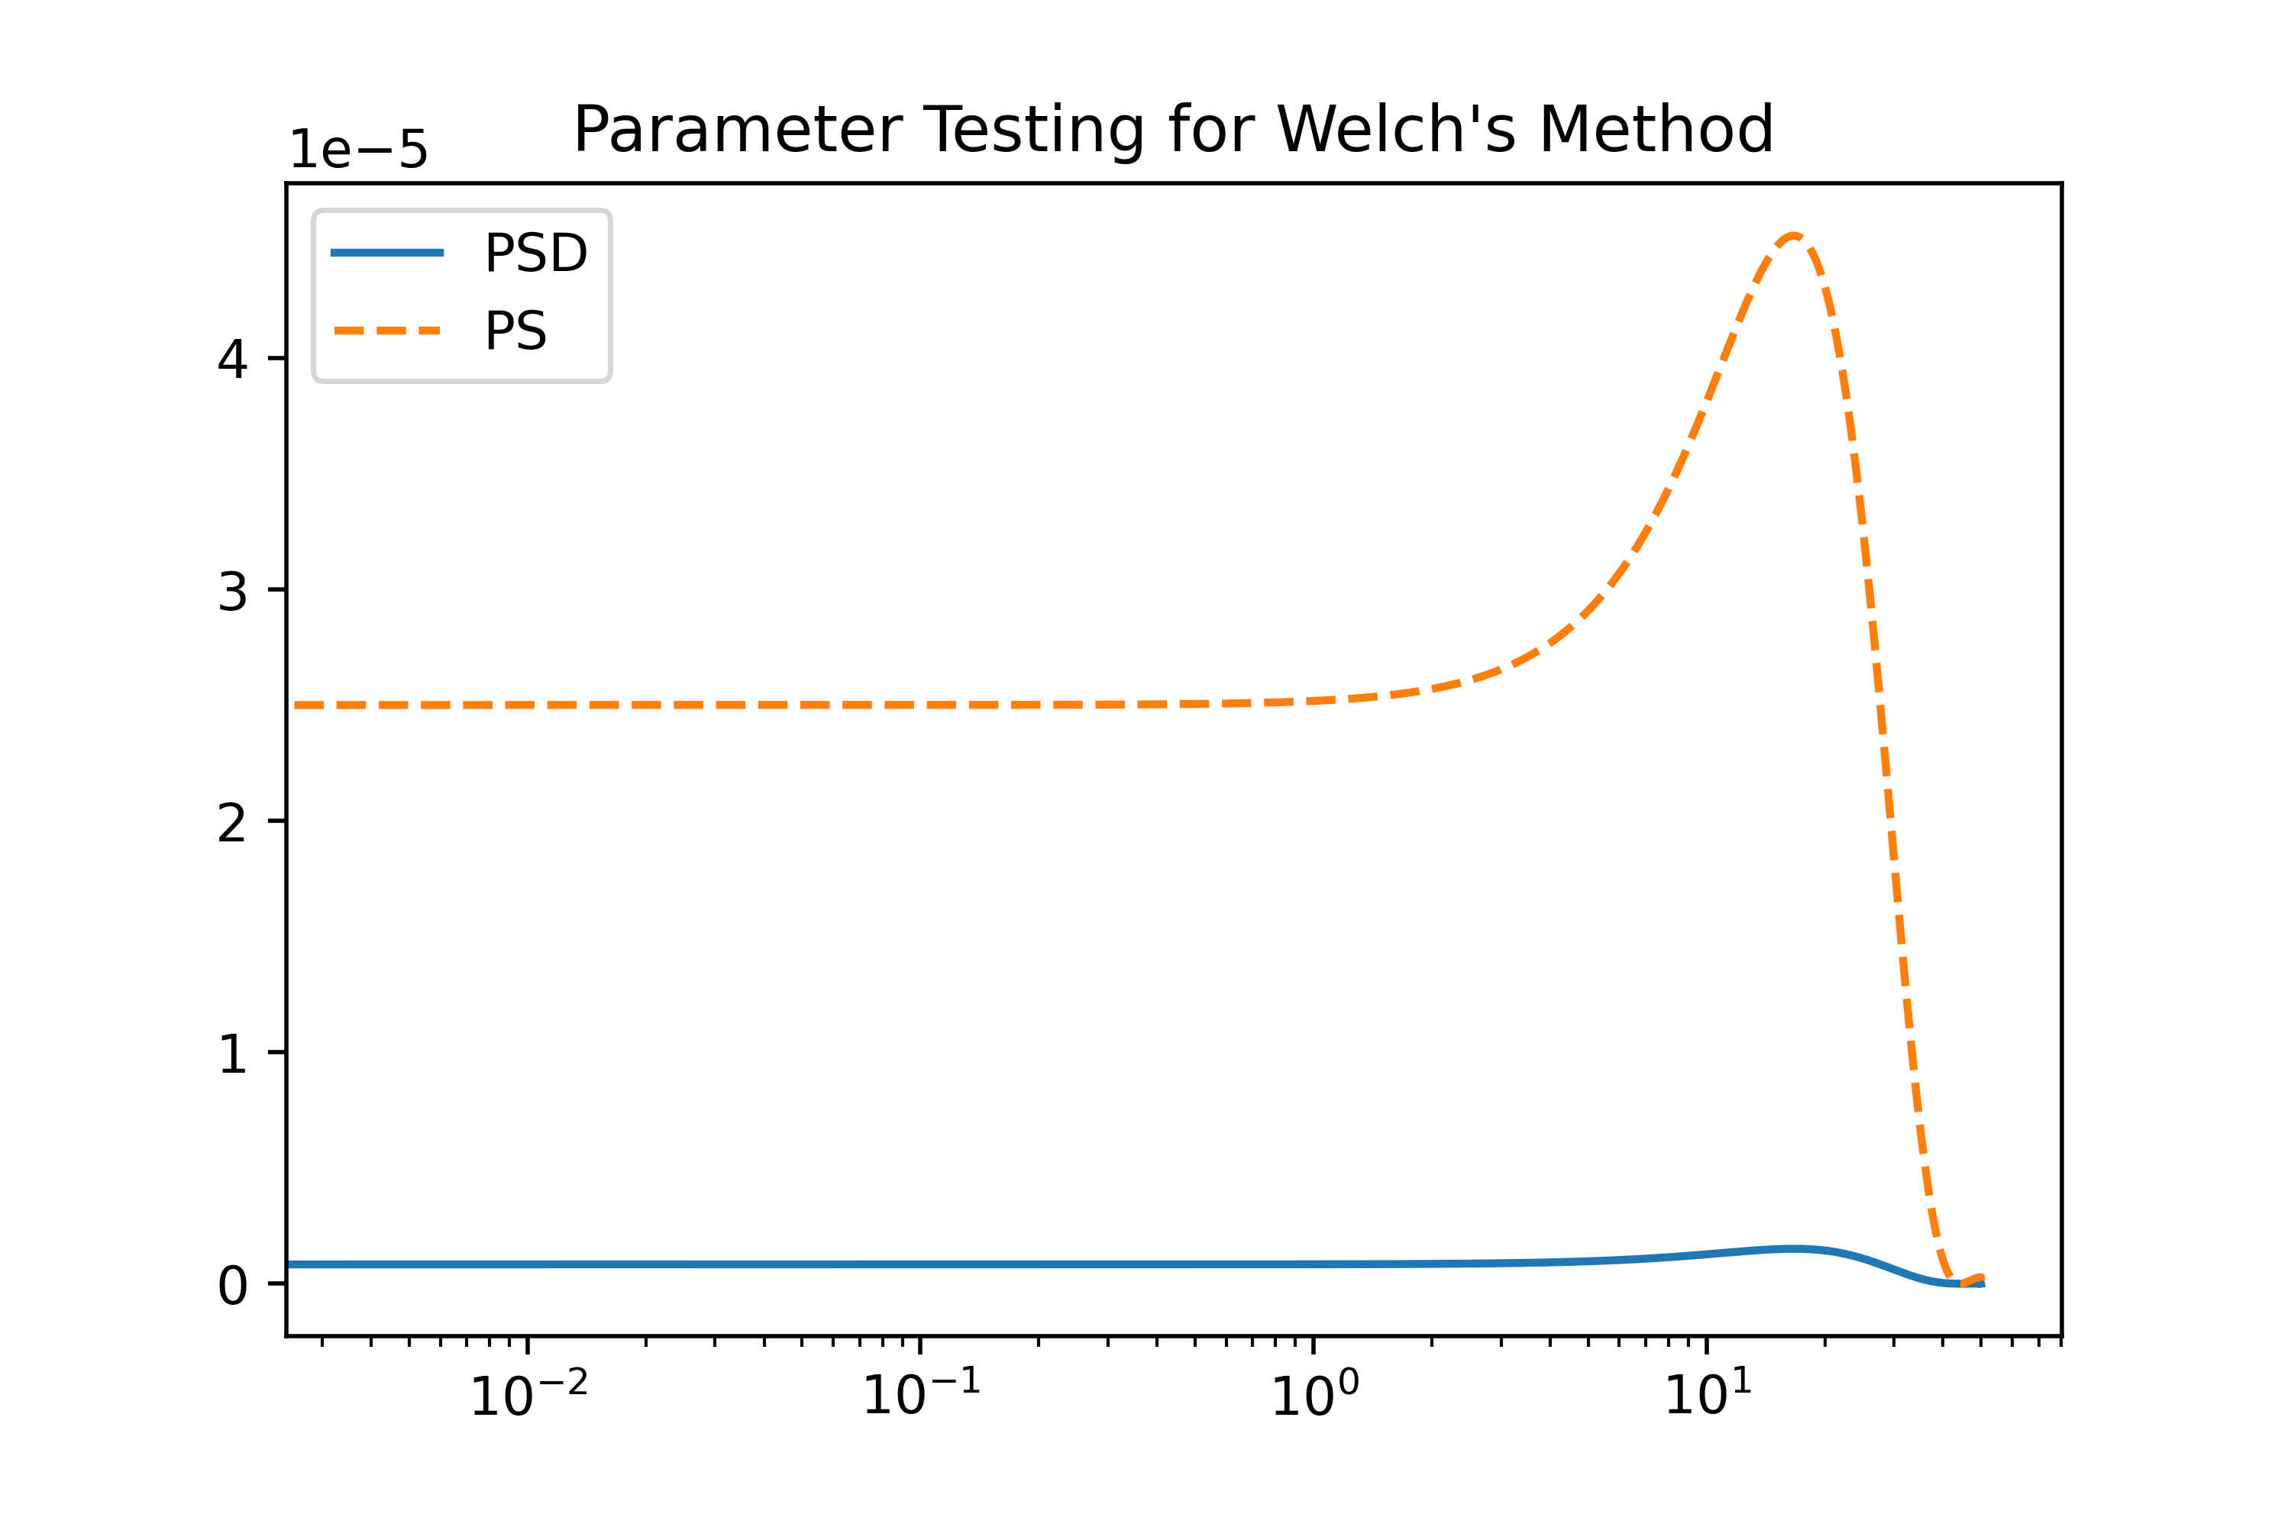
Parameter tuning - nperseg
Small window width = less smoothing, higher freq res
Wider window width = more smoothing, lower freq res
Nfft here is the full number of data points
Series split into 500 windows
Series split into 5000 windows

Slide 37
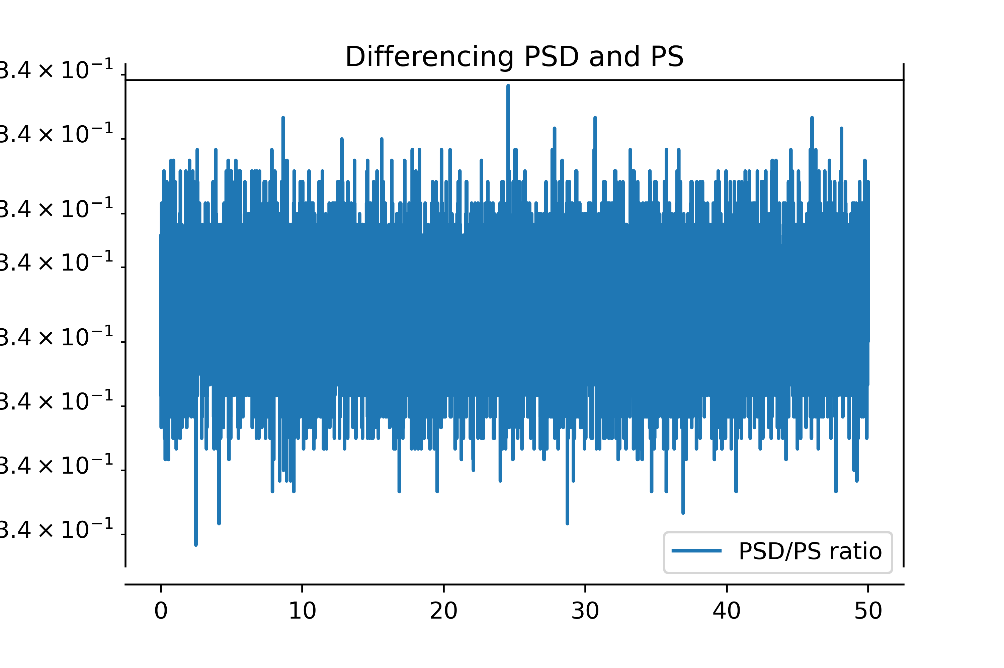
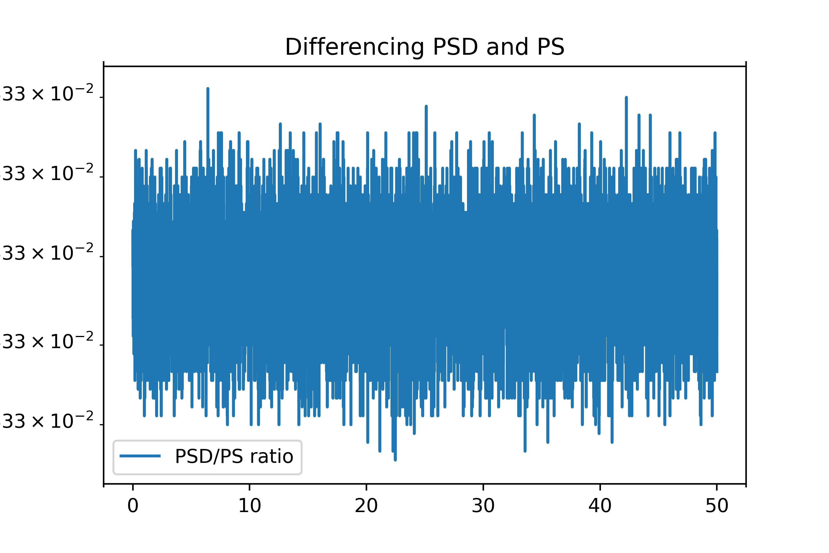
Parameter tuning - nperseg
Changes the factor between PSD and PS
What is controlling this?
Series split into 500 windows
Series split into 5000 windows

Slide 38
PSD after McNmara and Buland (2004)
(Thanks Morgan)

Slide 39
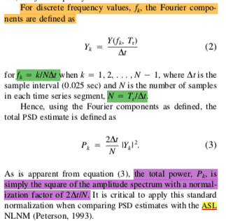
Following McNamara and Buland (2004)
Python methods use a DFT. We can definitely get ∆t and N.
Need to check if this is consistent with Welch’s method though (uses modified periodograms)

Slide 40
By hand discrete normalization - Synthetics
Try constructing PSD after McNmara/Buland from Kyle’s synthetics
Should just need sampling interval, Nfft, and Fourier amplitudes at all points
Outstanding issues:
Taper corrections for amplitudes?
Decibel conversion for comparison with NHNM and NLNM

Slide 41
Look at simple FFT of the synthetics first

Slide 42
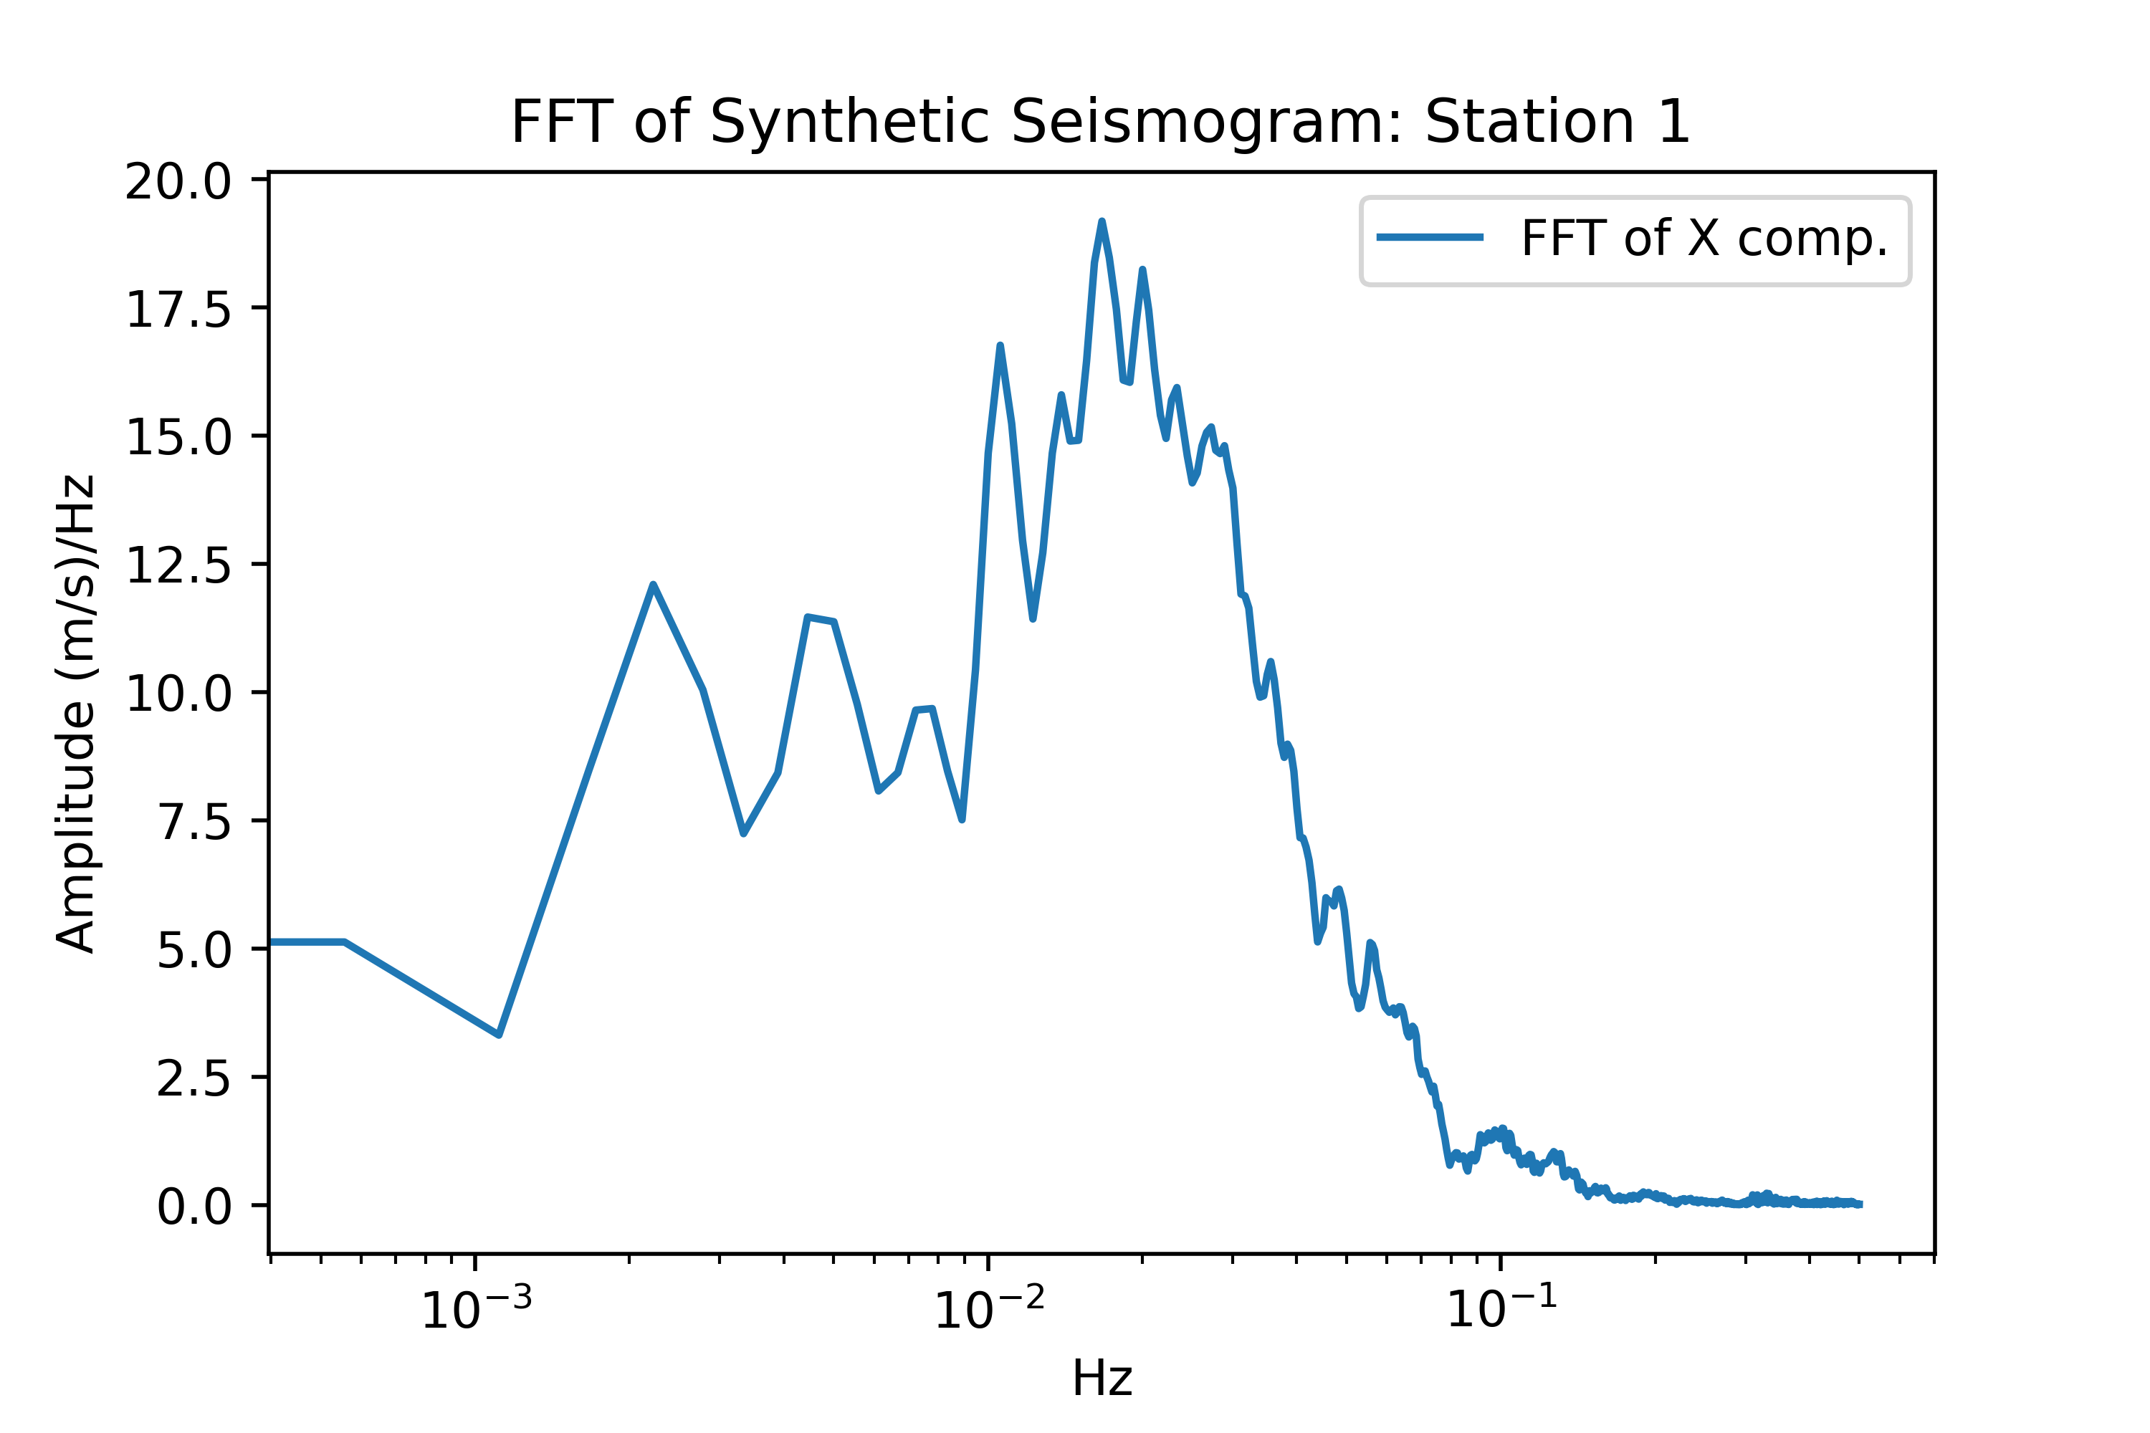
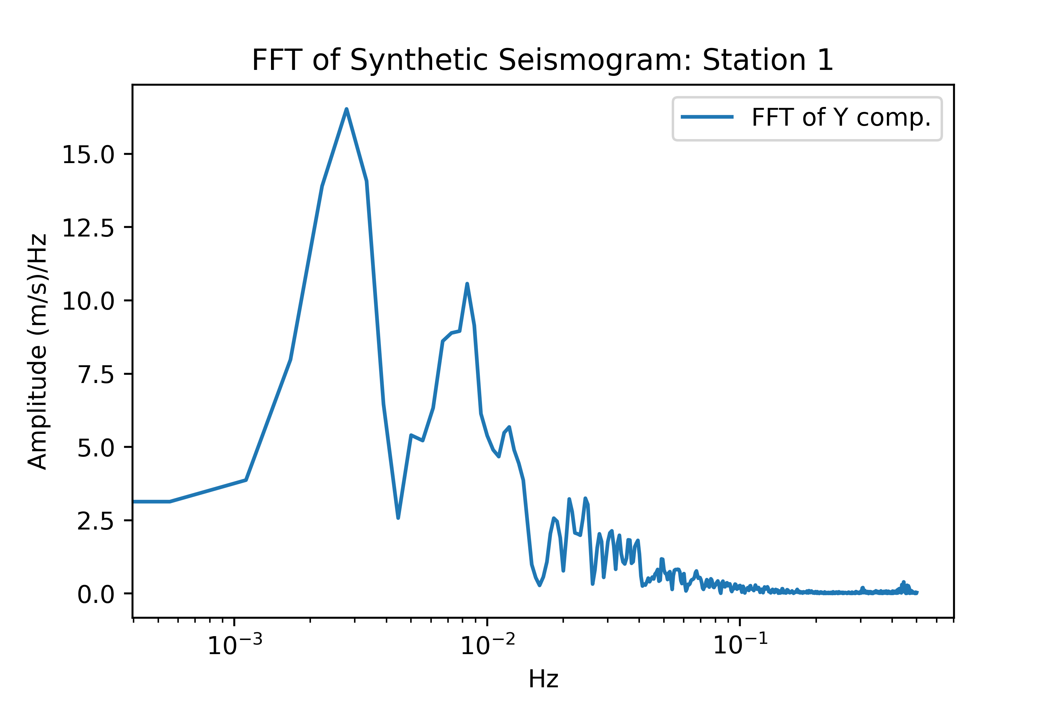
Comparing Power Spectra – Synth vs. Models
Start with checking what synthetic FFTs look like

Slide 43
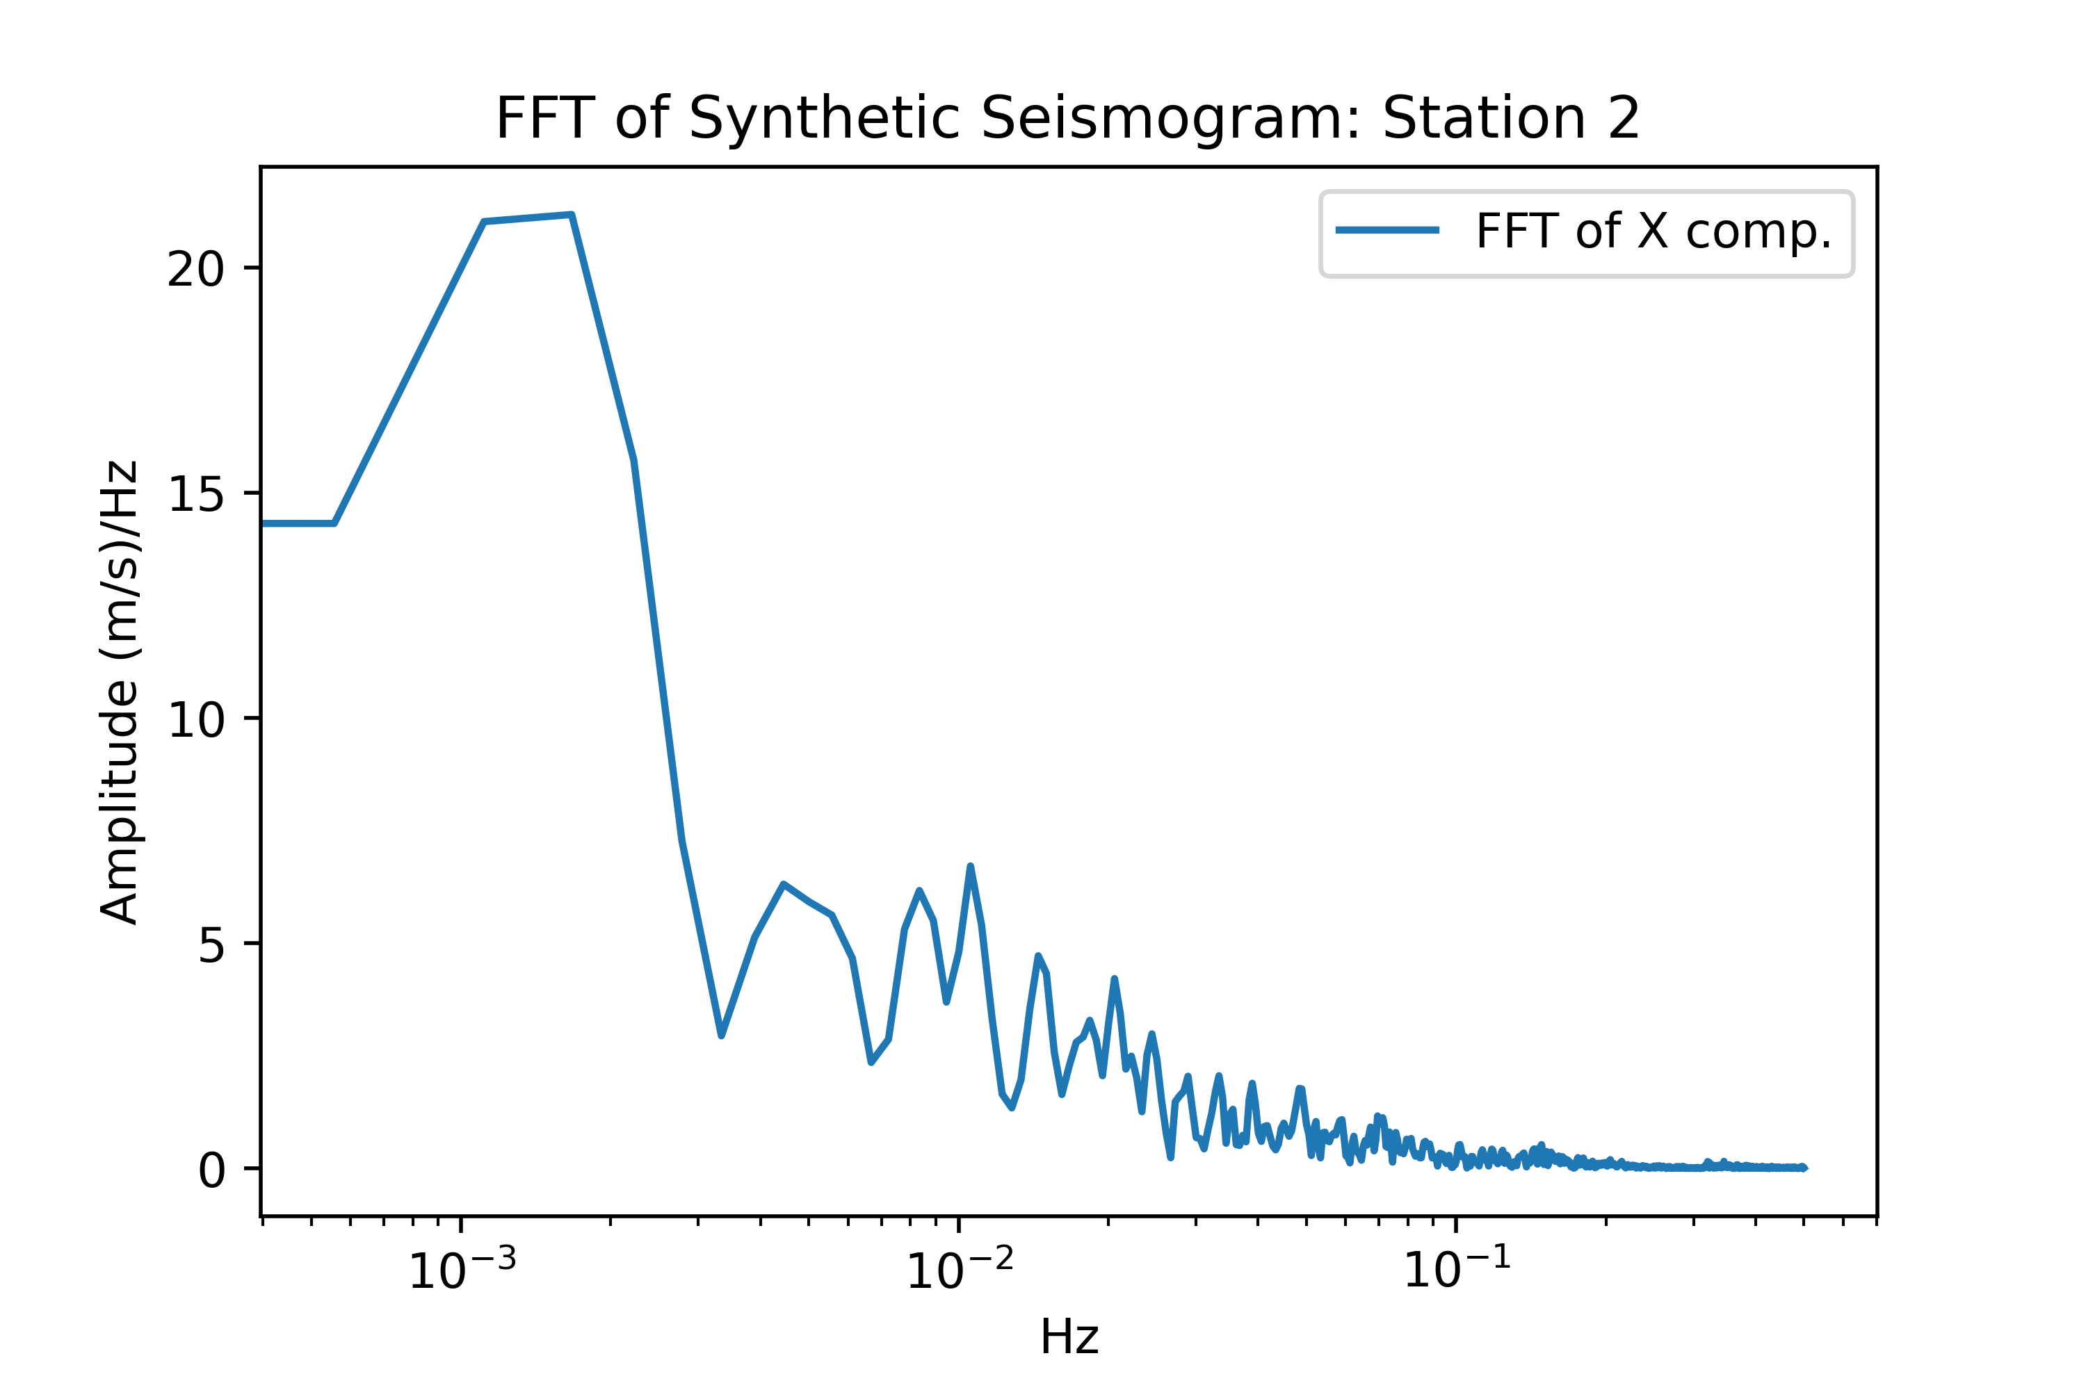
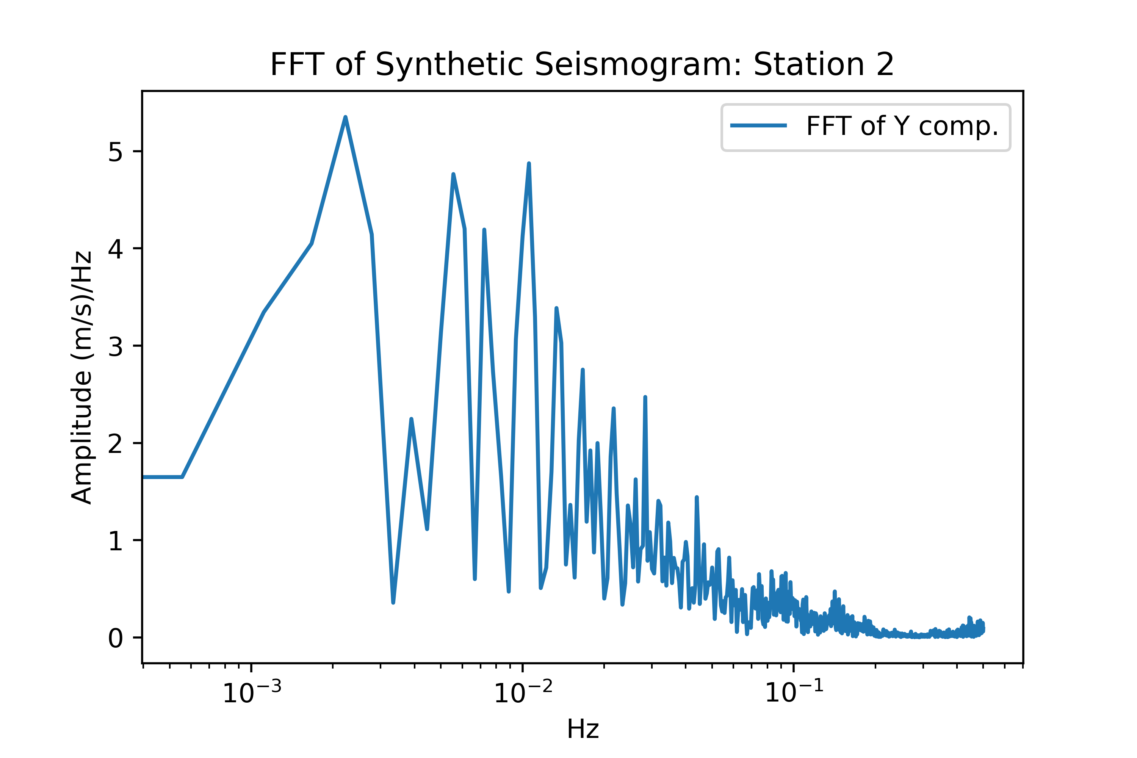
Comparing Power Spectra – Synth vs. Models
Start with checking what synthetic FFTs look like

Slide 44
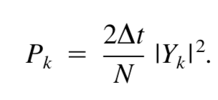
Compute PSD of synthetics after Mcnamara/Buland and compare

Slide 45
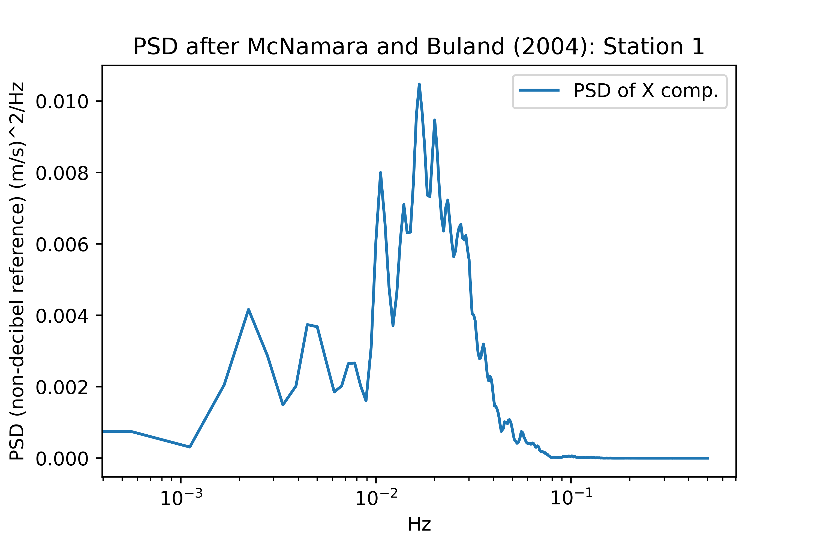
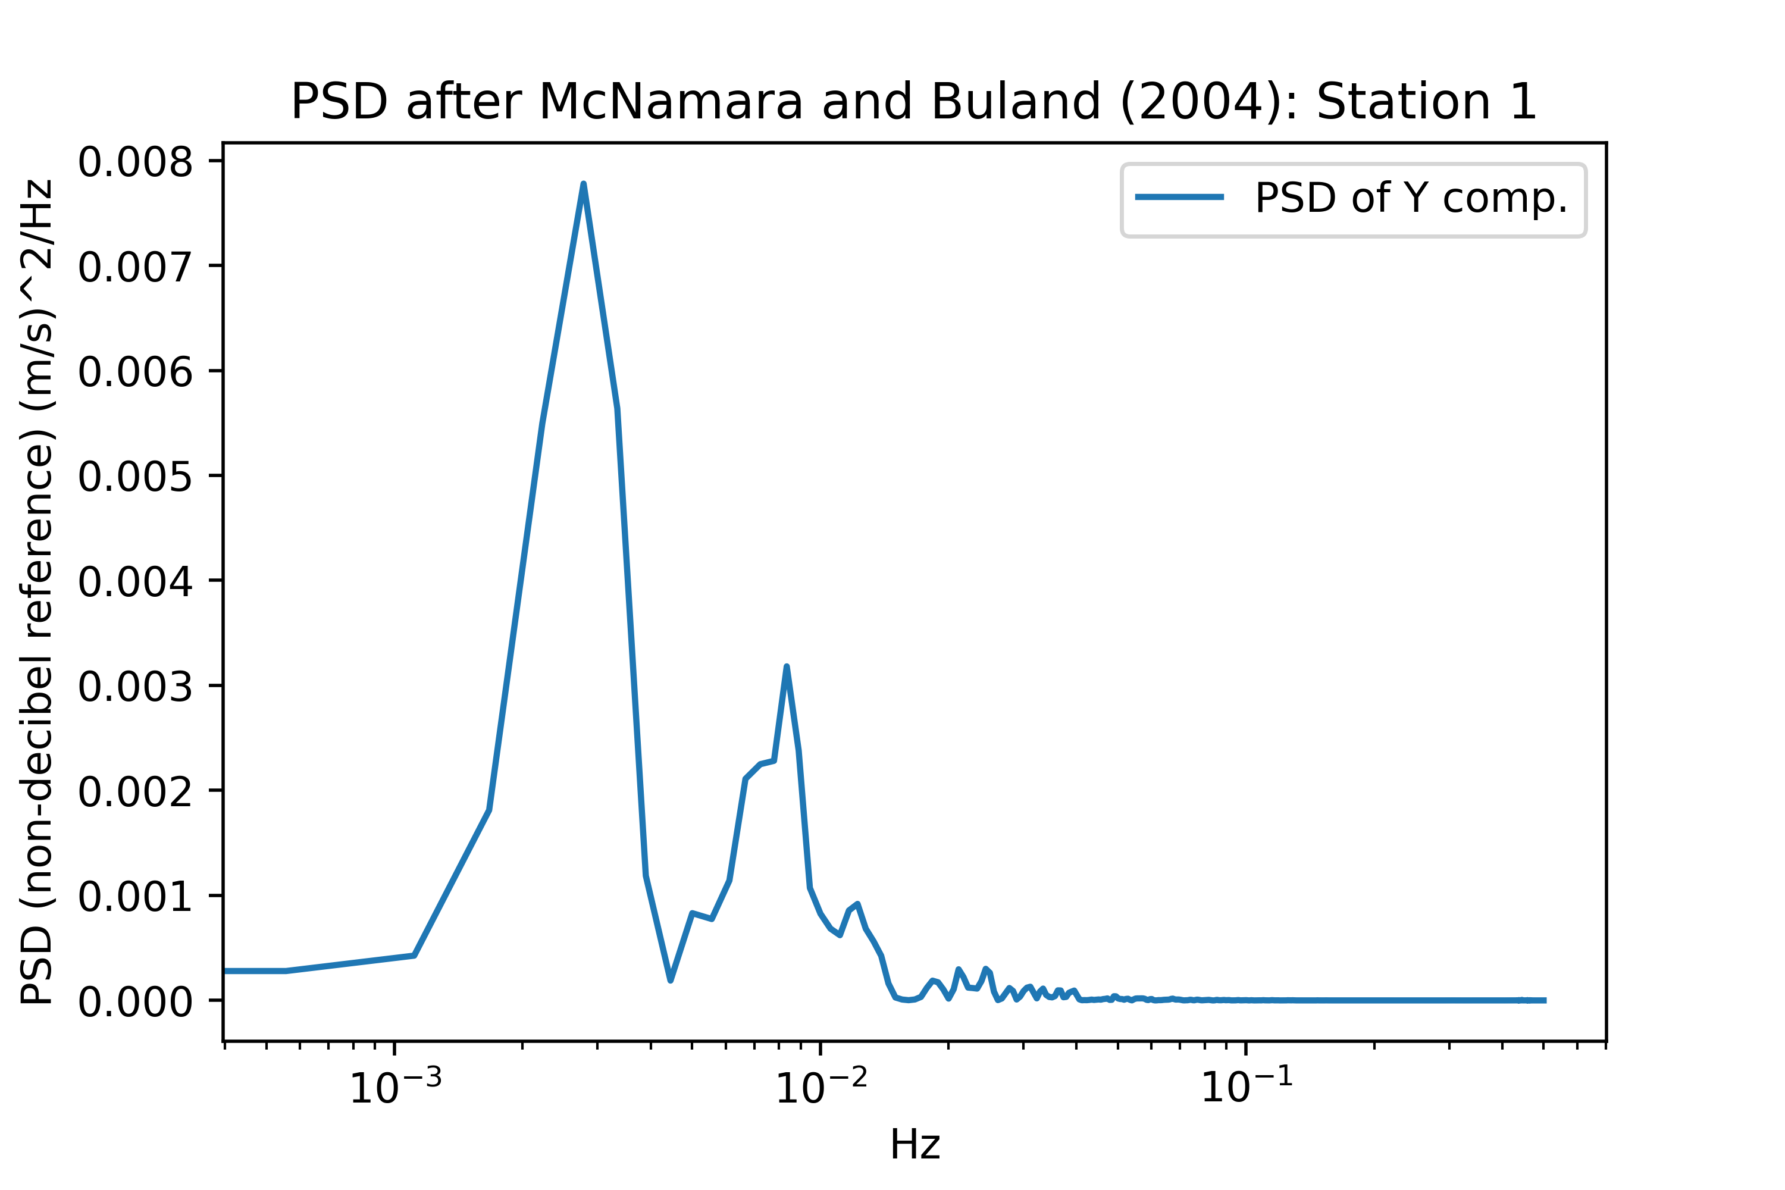
Computing Power Spectra - Synth vs. Models
Look at the manually calculated PSD from the synthetics

Slide 46
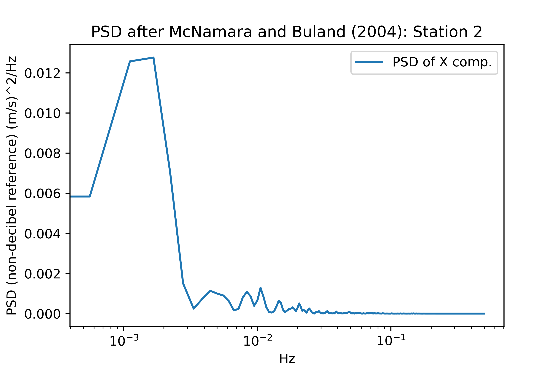
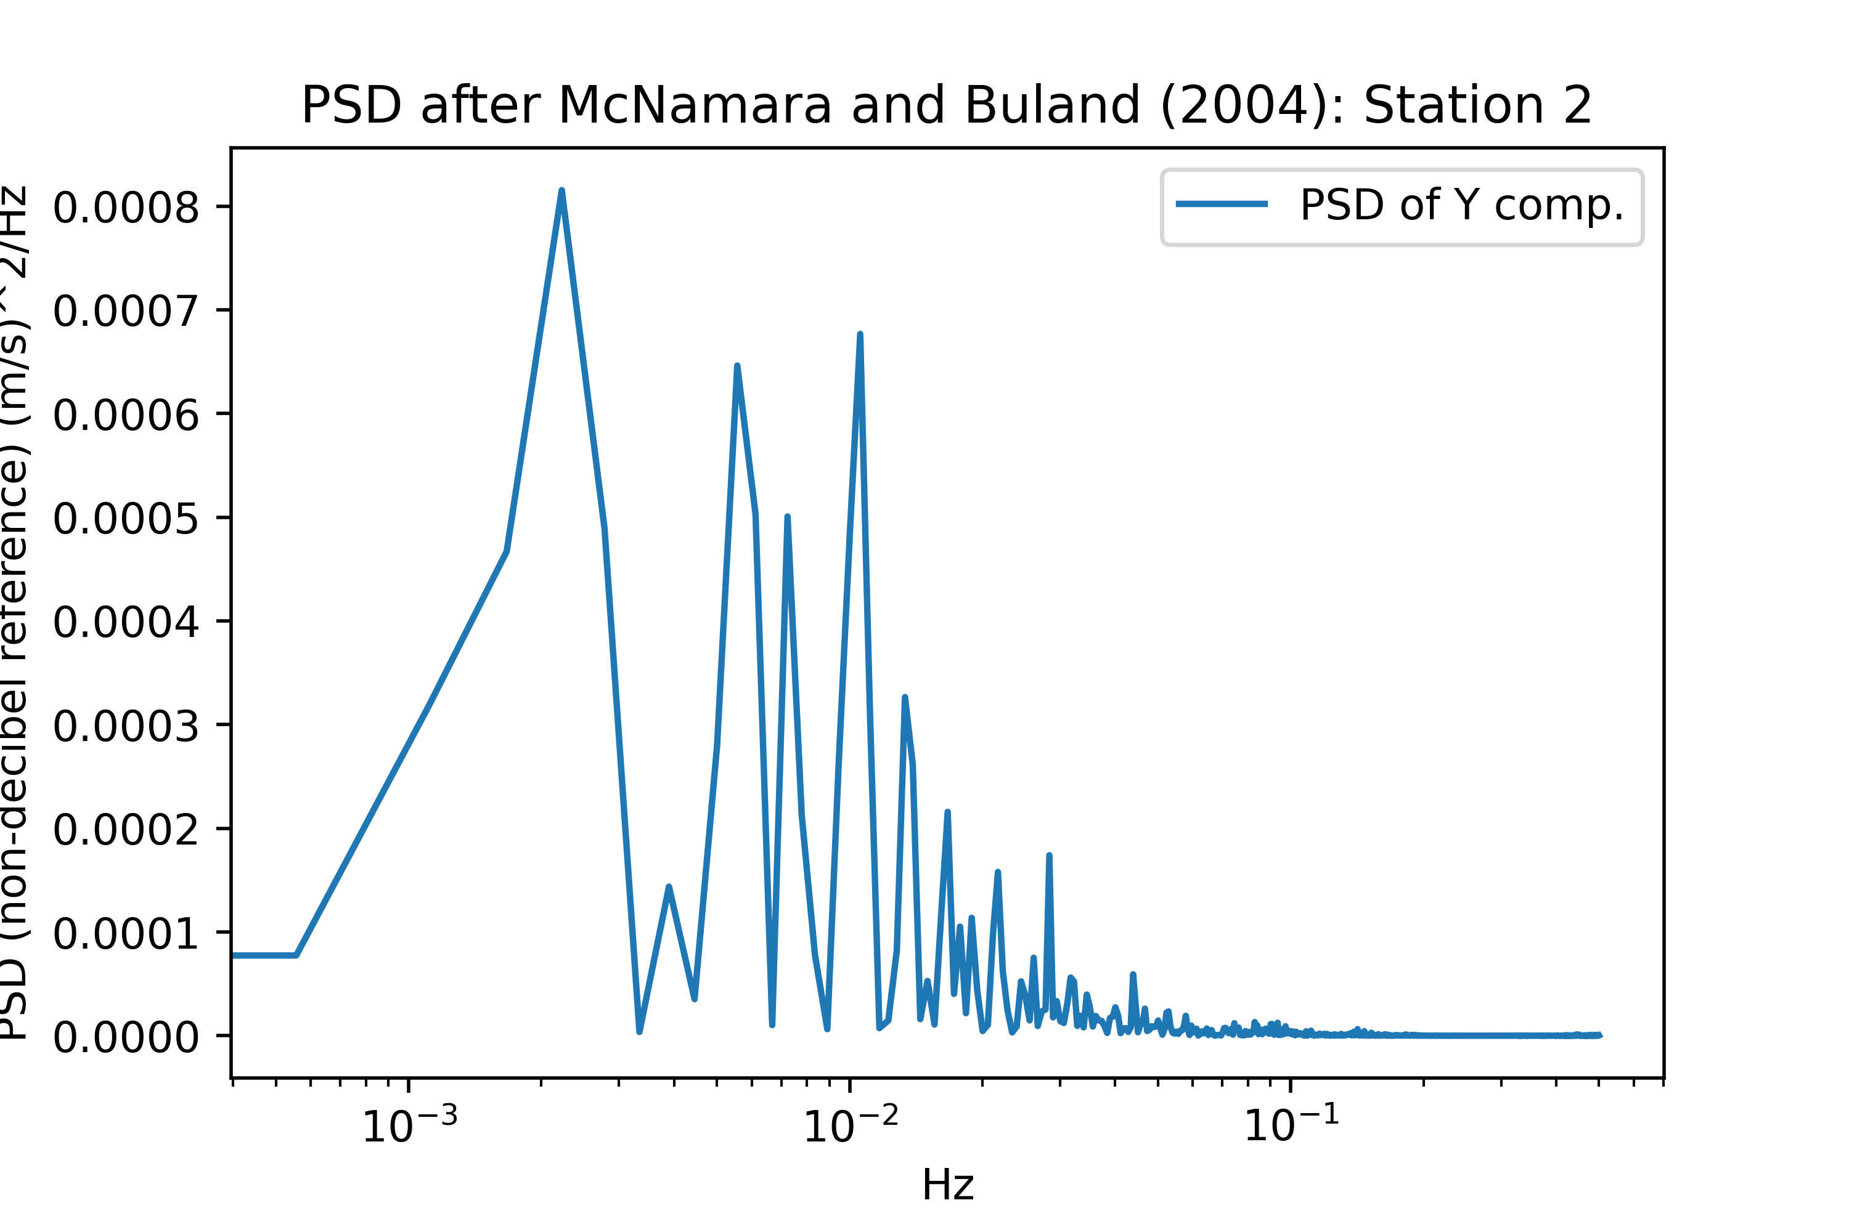
Computing Power Spectra - Synth vs. Models
Look at the manually calculated PSD from the synthetics

Slide 47
Following McNamara and Buland (2004)
But ...
Computing power discretely at every Fourier point is probably not appropriate
The authors also split their records into 13 overlapping segments (by 10%) and cosine taper them (probably Hann), and average across all of them to estimate PSD, later amplitude correcting for the tapers
Basically just Welch’s method

Slide 48
To - Do

Slide 49
Stuff to do
Use Welch’s method (same as McNamara/Buland) to get a better PSD estimate of input signals
Convert to decibel (dB) referencing for direct NHNM/NLNM comparison
Double/triple/quadruple check scaling/normalization is consistent
A little uncertain about taper corrections, we’ll see
Revisit stochastically generated noisy signals as comparison to NHNM/NLNM
Run both categories of new noisy signals through different filtering routines in gmprocess (bandpass vs. wavelet)

Slide 50
Units Pt. Deux : Redux
It became apparent that I remember very little about actually using decibels (dB) and power
From Wiki:
When expressing a power ratio, the number of decibels is ten times its logarithm to base 10.^{[2]} That is, a change in power by a factor of 10 corresponds to a 10 dB change in level. When expressing field (root-power) quantities, a change in amplitude by a factor of 10 corresponds to a 20 dB change in level
This is exactly what the units in the Peterson (1993) paper are, 10log₁₀() referenced to the units of acceleration / Hz, where Hz is only derived from the process of computing the Fourier Transform

Slide 51
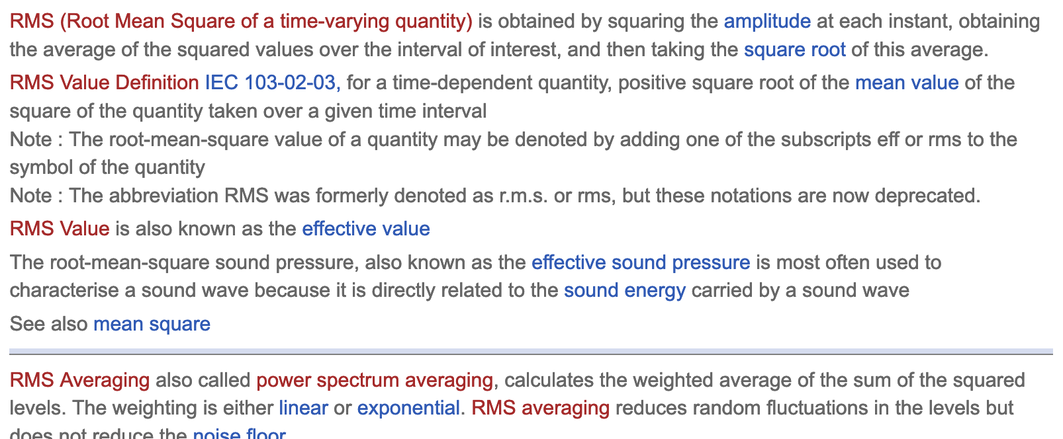
RMS

Slide 52
Getting back to models
Need to interpolate between sparse grid points and get a more finely sampled model
Initial issues with SciPy interps due to log scaling of period (frequency)
Looks better now

Slide 53
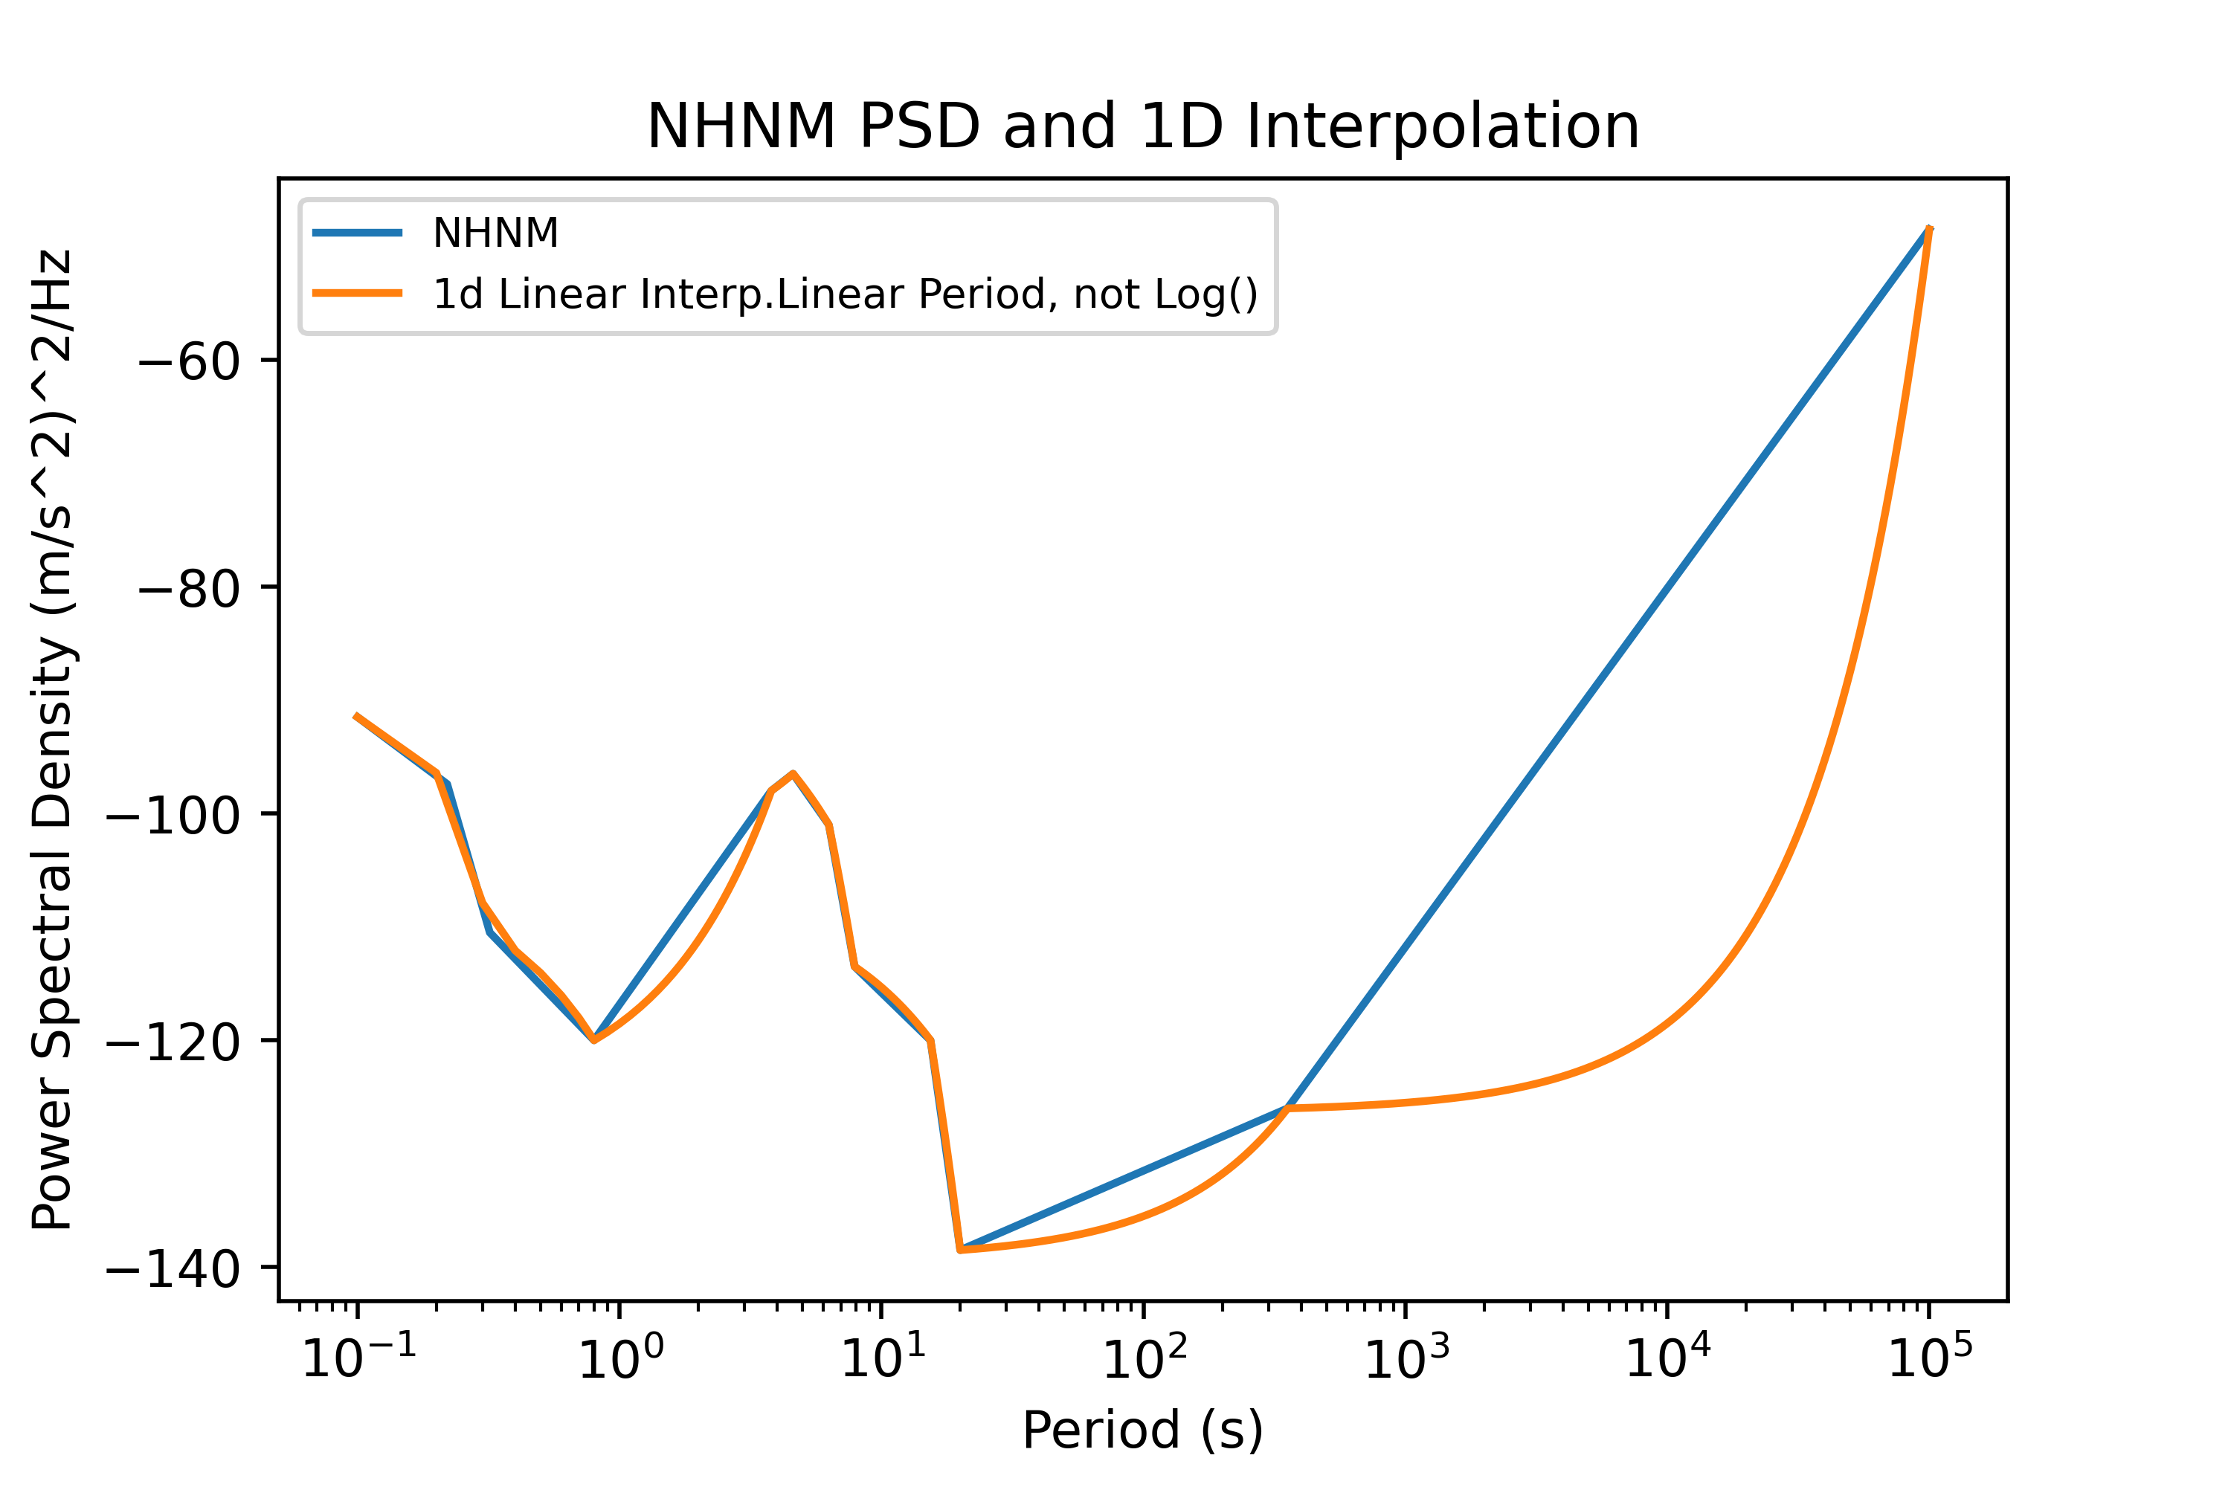
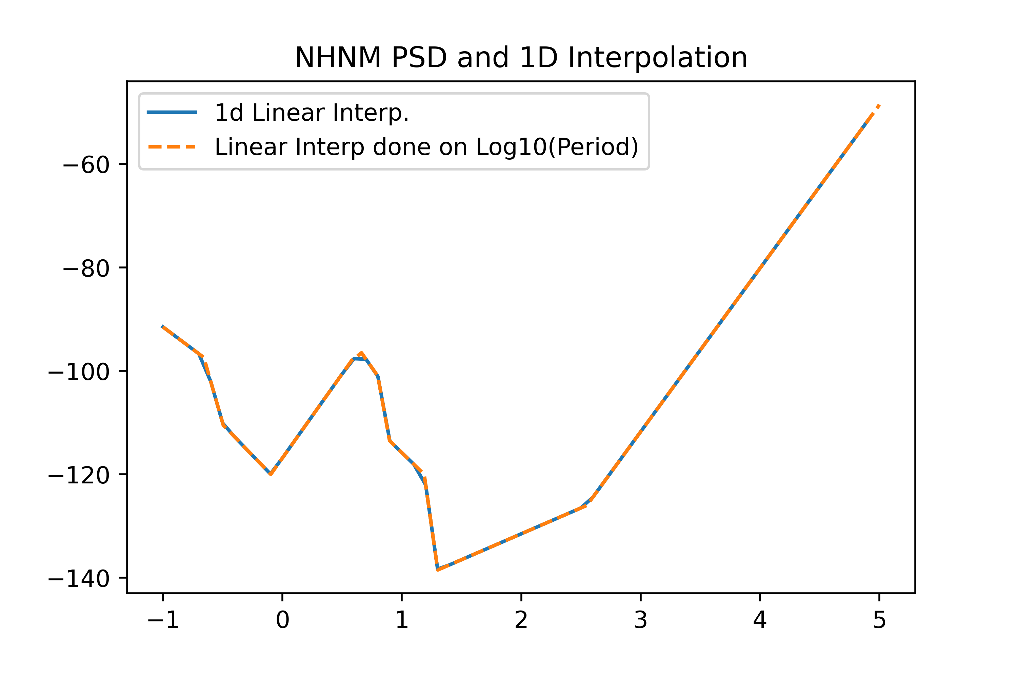
NHNM
Needed to transform period arrays to log space to get accurate interpolation

Slide 54
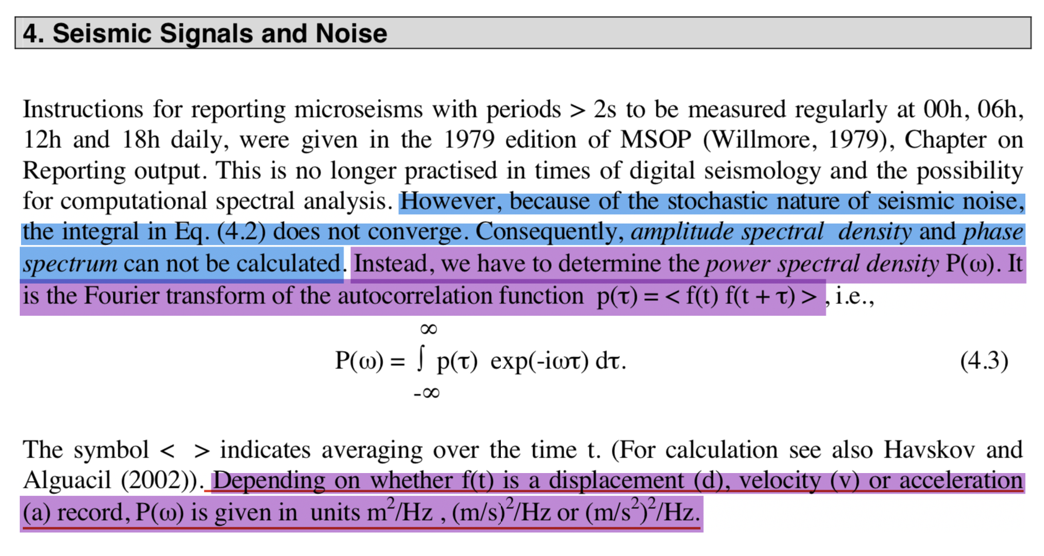
Seismic Signals and Noise - Bormann

Slide 55
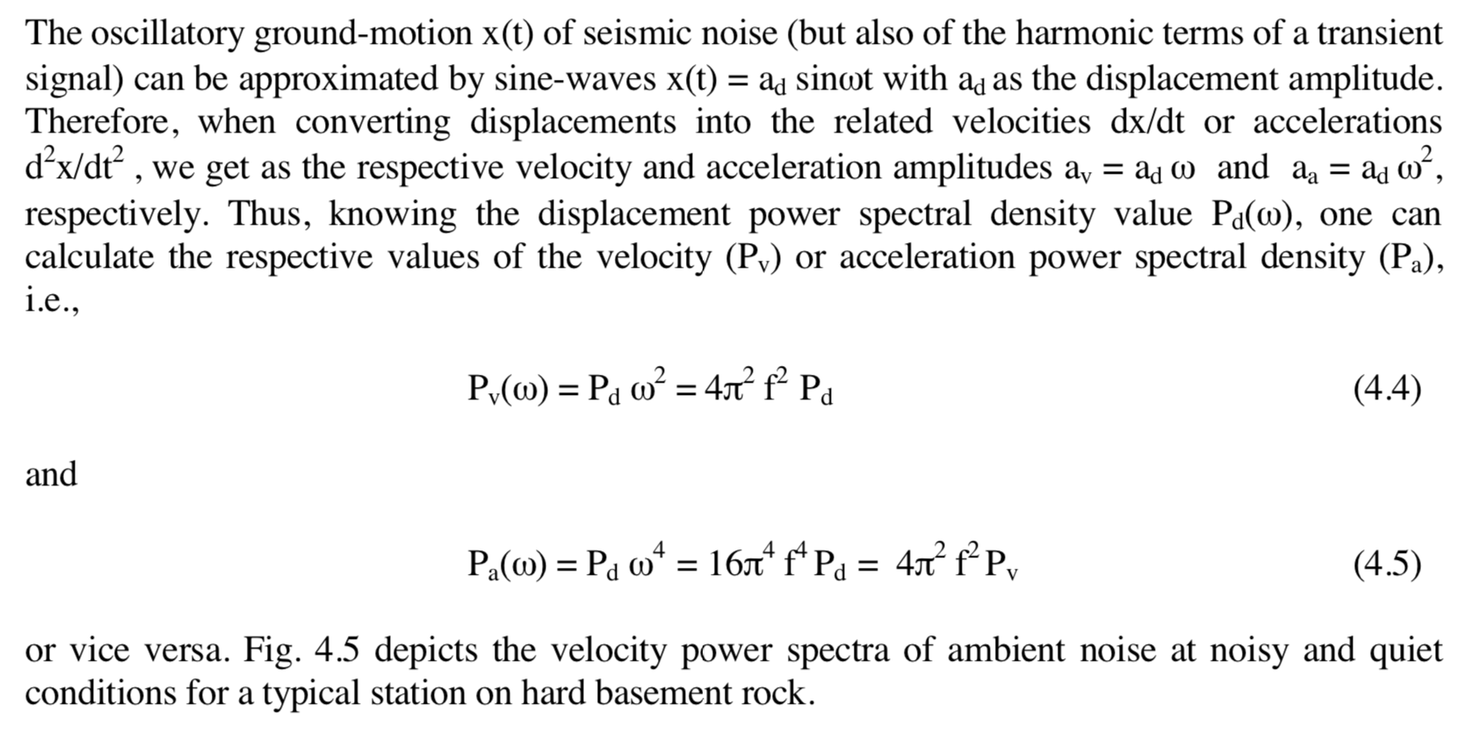
Seismic Signals and Noise - Bormann

Slide 56
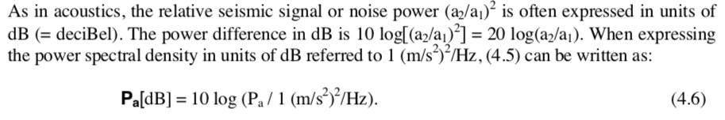
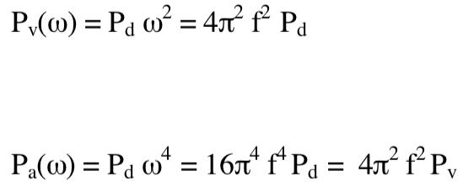
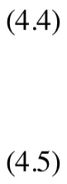
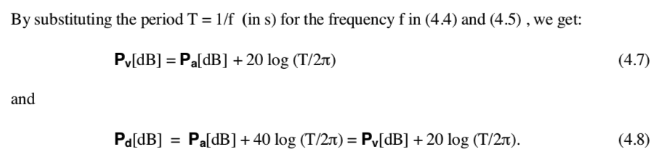
Seismic Signals and Noise - Bormann

Slide 57
Testing Wavelet Denoising

Slide 58
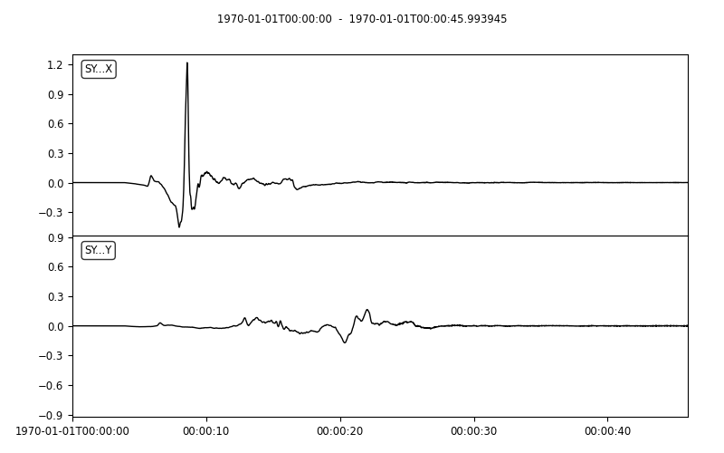
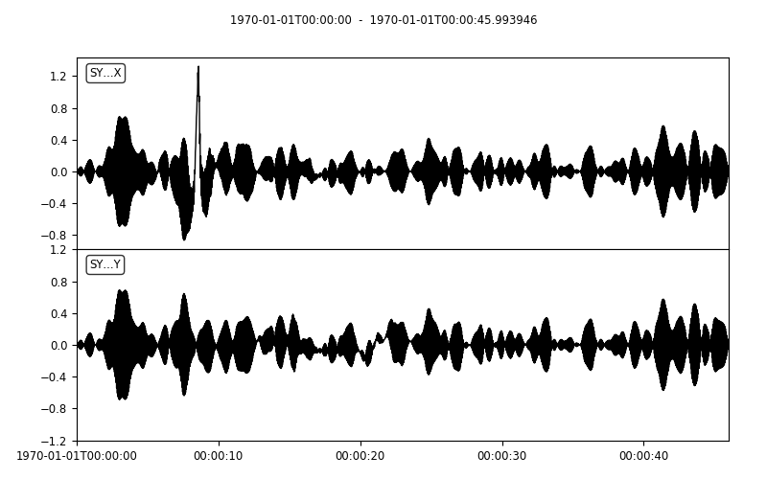
Wavelet Denoising Examples Original and noisy (working out the noise issues …)

Slide 59

Reconstructed signal (using soft threshold and Coiflet wavelet)

Slide 60

Noisy signal and reconstructed noise (using soft threshold and Coiflet wavelet)

Slide 61
Original (left) and reconstructed signal (right)

Slide 62


The other synthetic series, original and noisy
Mostly washed out by noise

Slide 63

Reconstructed signal using soft threshold and Coiflet wavelet

Slide 64

Original noisy signal (left) and reconstructed noise (right)

Slide 65
Original signal (left) and reconstructed signal (right)

